Slide 1
Client Side Scripting Language
By Palkar N.M.

Slide 2
Unit 5 Regular Expression,Rollover and Frames
* Regular Expression:
-A regular expression is a sequence of characters that forms a specific search pattern.
-Functions:
1.Search()
2.Replace()
3.Test()
-Syntax:
/pattern/modifiers;
e.g.var p=/student/I;

Slide 3
Language of Regular Expression
-A set of words that can be derived by using the regular expression is known as language of that regular expression.
*Special Characters:
1. Brackets
2.Qualifiers
3.Metacharacters
4.RegExp Functions

Slide 4
1. Brackets
Sr. No. | Expression | Description
1 | […..] | It specifies to find any one character between the brackets.
2 | [^…] | It specifies to find any one character not between the brackets.
3 | [0-9] | It specifies to find any decimal digit from 0 through 9.
4 | [a-z] | It specifies to find any character from lowercase a through lowercase z.
5 | [A-Z] | It specifies to find any character from uppercase A through uppercase Z.
6 | [a-Z] | It specifies to find any character from lowercase a through uppercase z.

Slide 5
2.Qualifiers
Sr. No. | Expression | Description
1 | p+ | It specifies to find any string containing one or more p’s.
2 | p* | It specifies to find any string containing zero or more p’s.
3 | p? | It specifies to find any string containing at most one p.
4 | p{N} | It specifies to find any string containing a sequence of N p’s.
5 | p{2,3} | It specifies to find any string containing a sequence of two or three p’s.
6 | p{2, } | It specifies to find any string containing a sequence of at least two p’s.
7 | p$ | It specifies to find any string with p at the end of it.
8 | ^p | It specifies to find any string with p at the beginning of it.

Slide 6
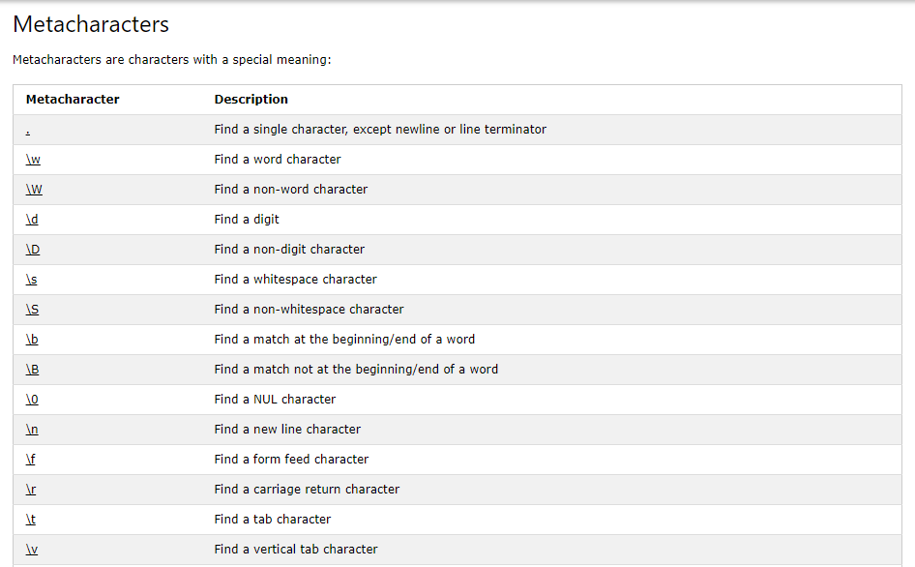
3.Metacharacters

Slide 7
4.RegExp Functions
Sr.No. | Method | Description
1 | compile() | Deprecated in version 1.5 compiles a regular expression
2 | exec() | Tests for a match in a string. Returns the first match
3 | test() | Tests for a match in a string. Returns true or false
4 | toString() | Returns the string value of the regular expression

Slide 8
*Finding Non-matching Characters
-Uses ‘^’ symbol.
*Entering Range of Characters
-For Matching a character from a-z:[a-z]
-For Matching any digit from 0-9:[0-9]

Slide 9
*Matching Digits and Non-digits
-For checking that string contains digits: \d
-For checking that string contains Non-digits:\D

Slide 10
*Matching Punctuations and Symbols
3 Ranges
$ to /
: to ?
{ to ~
*Matching Words
-The match() function is used.
e.g. var a=“I am a student.”;
var pat = a.match(/ent/g)

Slide 11
* Replacing a text using Regular Expression
- The replace() function is used.
e.g. var str=“It is an important data!”;
var res=str.replace(“data”,”information”);
* Returning a matched character
1. match()
String.match(pattern);
2. exec()
pattern.exec(string);

Slide 12
*Regular Expression and Object Properties
Syntax:
/pattern/modifiers;
*RegExp Object Properties:
Property | Description
constructor | Returns the function that created the RegExp object's prototype
global | Checks whether the "g" modifier is set
ignoreCase | Checks whether the "i" modifier is set
lastIndex | Specifies the index at which to start the next match
Multiline | Check whether the “m” modifier is set.
source | Returns the text of the RegExp pattern

Slide 13
Frame
HTML document can be divided into multiple parts by using frame.
* Create a Frame:
- Uses <frame> tag within <frameset> tag.
*Attributes of <frameset>:
Sr.No. | Attribute | Value | Description
1 | cols | Values of this attribute can be pixels,percentage and ‘*’ . | It specifies the number and size of column in frameset.
2 | rows | Values of this attribute can be pixels,percentage and ‘*’ . | It specifies the number and size of row in frameset.

Slide 14
Attributes of frame
Sr.No. | Attribute | Value | Description
1 | frameborder | 0 or 1 | 1 states that the frame with border ,0 states that f without border
2 | name | Any name | States the name of frame
3 | src | URL | It specifies the path of the html file.

Slide 15
*Invisible Borders of Frame
-Set the attributes ‘frameborder’ and ‘border’=0.
* Calling a child Window
- We can define one or more than one frames in a webpage ,then that webpage is become parent window, and the webpage present in frame become child window.

Slide 16
*Changing the content and focus of child window
The content and focus of child window can be changed from another child window.
*Accessing the elements of other child window:
- We can access the elements of child window from another child window.

Slide 17
* Rollover:
- We can change the appearance of the webpage by using mouse rollover.
* Creating Rollover:
- Uses “onmouseover” event.
* Text Rollover:
- If mouse is moved on text then a particular effect will be taken place.

Slide 18
* Multiple Actions for Rollover
It can be possible to perform multiple actions for rollover.
* More Efficient Rollover:
- By using addEventListener.
Syntax:
addEventListener(“mouseover/mouseout”,function_name);

Slide 19
Thank You!

