Slide 1
Name of Faculty :-mrs. Yadav k.s
Name of Subject:- Data Communication & computer network
Unit 1:- Fundamentals of Data Communication and Computer Network

Slide 2
Data Communication is the transmission of digital data through a network.
It is basis of computer networks.
Students of IT required to handle data communication related problems.
This subject enables to have insight into technology involved to make the network communication possible.
The term telecommunication means communication at a distance.
The word data refers to information presented in whatever form is agreed upon by the parties creating and using the data.
Data communication means the exchange of data between two devices via some form of transmission medium such as a wire cable.

Slide 3
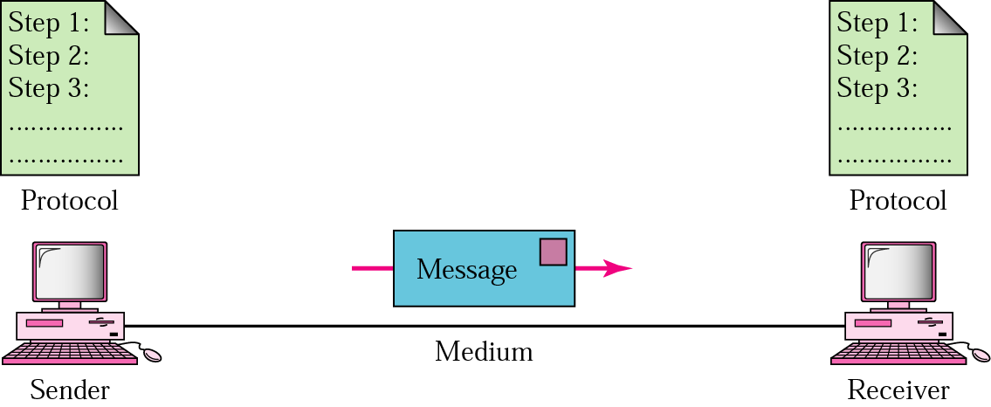
Fundamental Characteristics
The effectiveness of a data communication system depend on four characteristics:
Delivery: correct Destination
Accuracy: Data must be accurately delivered
Timelines: Deliver data in timely manner
Jitter: Variation in packet arrival time.
Components of Data Communication
Message 2. Sender 3. Receiver
4. Medium 5. Protocol

Slide 4
Message- The message is the information (data) to be communicated. Popular forms of information include text, numbers, pictures, audio, and video.
Sender. The sender is the device that sends the data message. It can be a computer, workstation, telephone, video camera.
Receiver. The receiver is the device that receives the message. It can be a computer, workstation, telephone, television,& so on.
Transmission medium. The transmission medium is the physical path by which a message travels from sender to receiver.
Examples of transmission media include twisted-pair, coaxial, fiber-optic, and radio waves.
Protocol. A protocol is a set of rules that govern data communications. It represents an agreement between the communicating devices.
Protocol is a set of rules that govern all aspect of data communication between computers on a network.
These rules include guidelines to regulate: access method, allowed physical topologies, types of cabling, and speed of data transfer.
A protocol defines what, how, when it communicated.

Slide 5
Standards
Standards are essential in creating and maintaining an open and competitive market for equipment manufacturers and in guaranteeing national and international interoperability of data and telecommunications technology and processes.
Standards provide guidelines to manufacturers, vendors, government agencies to ensure the interconnectivity.
Data communication standards fall into two categories: de facto (meaning "by fact" or "by convention") and de jure (meaning "by law" or "by regulation").
De-facto. Standards that have not been approved by an organized body but have been adopted as standards through widespread use are de facto standards. De facto standards are often established originally by manufacturers who seek to define the functionality of a new product or technology.
De-jure. Those standards that have been legislated by an officially recognized body are de-jure standards.

Slide 6
Standards are developed by cooperation among standards creation committees, forums, and government regulatory agencies.
Standards Creation Committees
International Standards Organization (ISO)
International Telecommunications Union (ITU)
American National Standards Institute (ANSI)
Institute of Electrical and Electronics Engineers (IEEE)
Electronic Industries Association (EIA)
Internet Engineering Task Force (IETF)
Bandwidth is also called as data transfer rate.
Moving data from one point to another, in a given time period (usually a second), is called bandwidth.
Bandwidth is indicated by bits (of data) per second (bps).

Slide 7
Bandwidth is also called as data transfer rate.
Moving data from one point to another, in a given time period (usually a second), is called bandwidth.
Bandwidth is indicated by bits (of data) per second (bps).
Bandwidth is defined as the portion of electromagnetic spectrum occupied by a signal.
Bandwidth is the difference between the upper and lower frequency limits of signal.
Example:
Voice signal ranges from 20Hz to 20KHz,
BW=f2-f1=20000-20=19980Hz

Slide 8
The speed of the data is expressed in bits per second (bits/s or bps).
The data rate R is a function of the duration of the bit or bit time (TB):
R = 1/TB
Rate is also called channel capacity C. If the bit time is 10ns, the data rate equals:
R = 1/10 x 10⁹ = 100 million bits/s .
This is usually expressed as 100 Mbits/s.
bit: a unit of information
baud: a unit of signalling speed.
Bit rate:b
Number of bits transmitted per second.
Baud Rate:s
Number of symbols transmitted per second.
General formula:
b=s*n
Where n is number of bits per symbol.

Slide 9
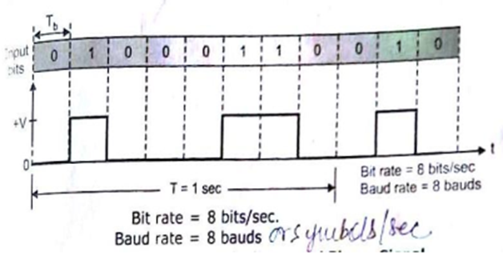
Baud Rate
The term “baud” originates from the French engineer Emile Baudot, who invented the 5-bit teletype code.
Baud rate refers to the number of signal or symbol changes that occur per second.
A symbol is one of several voltage, frequency, or phase changes.
Binary has two symbols, one for each bit 0 or 1, that represent voltage levels.
In this case, the baud or symbol rate is the same as the bit rate.
However, it’s possible to have more than two symbols per transmission interval, whereby each symbol represents multiple bits.
For example, 1500 baud rate illustrates that the channel state can alter upto 1500 times per second. per second.

Slide 10
Bit Rate Vs Baud Rate
BASIS FOR COMPARISON | BIT RATE | BAUD RATE
Basic | Bit rate is the count of bits per second. | Baud rate is the count of signal units per second.
Meaning | It determines the number of bits traveled per second. | It determines how many times the state of a signal is changing.
Term usually used | While the emphasis is on computer efficiency. | While data transmission over the channel is more concerned.
Bandwidth determination | Can not determine the bandwidth. | It can determine how much bandwidth is required to send the signal.
Equation | Bit rate = baud rate x the count of bits per signal unit | Baud rate = bit rate / the number of bits per signal unit

Slide 11
Modes of Communication
Communication between two devices ie sender and receiver can be of three types:
Simplex
Half-Duplex
Full-Duplex

Slide 12
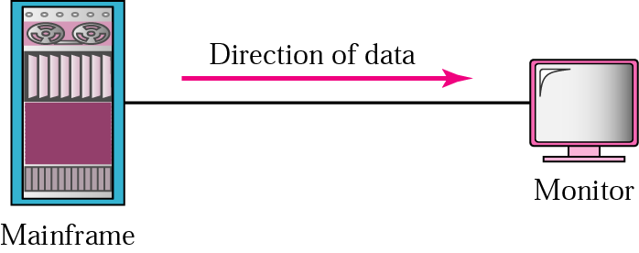
Simplex
In simplex mode, the communication is unidirectional.
Only one of the devices on a link can transmit, the other can only receive.
e.g. keyboards, monitors, etc.

Slide 13

Half-duplex
In this mode, each station can both transmit and receive, but not at the same time.
When one device is sending, the other can only receive, and vice-versa.
e.g. walkie-talkies, CB(citizens band) etc.

Slide 14

Full Duplex
In full duplex mode, both stations can transmit and receive simultaneously.
One common example of full duplex is the Telephone network.
When two people are communicating by a telephone line, both can talk and listen at the same time.

Slide 15
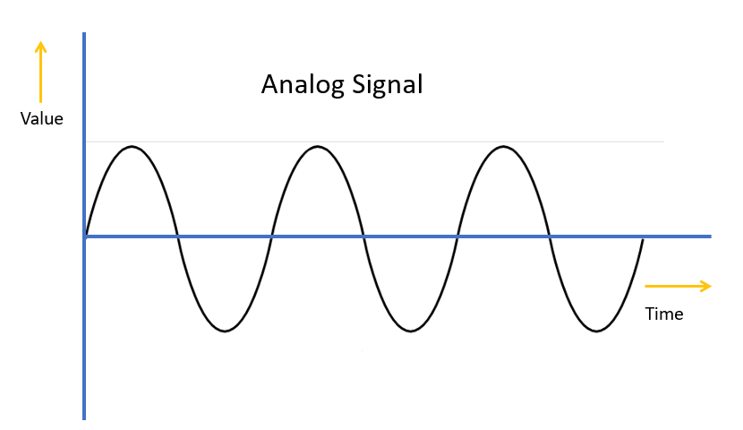
Analog Signal
An analog signal are continuous and passes through or includes an infinite number of continuous values along its path.
Analog signal is a continuous signal, in which, one time-varying quantity represents another time-based variable.
Sine wave is fundamental form of periodic analog signal.
These kind of signals works with physical values and natural phenomena such as earthquake, frequency, volcano, speed of wind, weight, lighting, etc.
Characteristics Of Analog Signal
These type of electronic signals are time-varying
Minimum and maximum values which is either positive or negative.
It can be either periodic or non-periodic.
Analog Signal works on continuous data.

Slide 16
Advantages of Analog Signals
Easier in processing
Best suited for audio and video transmission.
It has a low cost and is portable.
It has a much higher density so that it can present more refined information.
Disadvantages of Analog Signals
Analog tends to have a lower quality signal than digital.
The cables are sensitive to external influences.
The cost of the Analog wire is high and not easily portable.
Low availability of models with digital interfaces.
It offers limitations in editing
Quality is easily lost

Slide 17
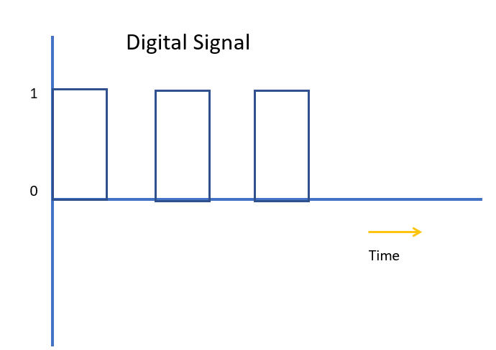
Digital Signal
A digital signal can have only a limited number of defined values.
Although each value can be any number, it is as simple as 1 and 0.
All binary signals are digital, but all digital signals are not necessarily binary.
A digital signal is a signal that is used to represent data as a sequence of separate values at any point in time. It can only take on one of a fixed number of values. This type of signal represents a real number within a constant range of values.

Slide 18
Characteristics of Digital Signals
Digital signals can be processed and transmitted better compared to analog signal.
Digital signals are versatile, so it is widely used.
The accuracy of the digital signal is better than that of the analog signal.
Advantages of Digital Signal
Digital signals are more secure, and they do not get damaged by noise.
These signals use low bandwidth
They allow the signals transmitted over a lengthy distance.
Digital signal has a higher rate transmission
By using these signals, we can translate the messages, audio, video into device language.
Disadvantage of Digital Signals
Sampling may cause loss of information.
A/D and D/A demands mixed-signal hardware
Processor speed is limited
Develop quantization and round-off errors
It requires greater bandwidth
Systems and processing is more complex.

Slide 19
Analog Signals | Digital Signals
It is a continuous signal. | discrete time signals
Denoted by sine waves | Denoted by square waves
More likely to get affected reducing accuracy | Less affected since noise response are analog in nature
Best suited for audio and video transmission | Best suited for Computing and digital electronics.
Analog signal processing can be done in real time and consumes less bandwidth. | No guarantee that digital signal processing can be done in real time & consumes more bandwidth to carry same information.
Stored in the form of wave signal | Stored in the form of binary bit
Analog instrument draws large power | Digital instrument draws only negligible power
Low cost and portable | Cost is high and not easily portable
Human voice in air, analog electronic devices. | Computers, CDs, DVDs, and other digital electronic devices.

Slide 20
Analog and Digital data
Analog data take on continuous values in time interval.
For example, voice and video are continuously varying patterns of intensity. Most data collected by sensors, such as temperature and pressure, are continuous valued.
The most familiar example of analog data is audio, which, in the form of acoustic sound waves, can be perceived directly by human beings.
Digital data take on discrete values; examples are text and integers.
They cannot be easily stored or transmitted by data processing and communications systems in character form.
Morse code, International Reference Alphabet (IRA) are used to translate text into binary.

Slide 21
Analog Transmission
Digital Transmission

Slide 22
Analog transmission
Analog transmission: is a means of transmitting analog signals without regard to their content; the signals may represent analog data (e.g., voice) or digital data.
In either case, the analog signal will become weaker (attenuate) after a certain distance.
To achieve longer distances, the analog transmission system includes amplifiers that boost the energy in the signal.
Unfortunately, the amplifier also boosts the noise components.

Slide 23
Digital transmission
Digital transmission: is the transfer of data (a digital bitstream or a digitized analog signal) over a point-to-point or point-to-multipoint communication channel.
Examples of such channels are copper wires, optical fibers, wireless communication channels, storage media and computer buses.
The data are represented as an electromagnetic signal, such as an electrical voltage, radiowave, microwave, or infrared signal.
A digital signal can be transmitted only a limited distance before attenuation.

