Slide 1
Unit 1 Introduce on to Management Concept and Managerial Skills

Slide 2
Objective
1 . List the areas of functional management.
2. Explain the concept of areas of functional management.
3. Identify the managerial Skills.
4. Suggest the suitable managerial Skills in a given situation .

Slide 3
Management
Definition:The process of planning, organizing, leading, and controlling resources to achieve organizational goals effectively and efficiently.
Key Features:Goal-Oriented: Focuses on achieving specific objectives.Continuous Process: A cycle that never ends.Multidimensional: Involves managing people, tasks, and technology.
Importance:Drives productivity and innovation.Aligns individual goals with organizational objectives.
Efficiency vs. Effectiveness:
Efficiency: Doing things right (minimal resources).
Effectiveness: Doing the right things (achieving goals).
Levels of Management:
Top-level (e.g., CEOs, Board Members) – Strategic decisions.
Middle-level (e.g., Department Heads) – Bridge between top and lower management.
Lower-level (e.g., Supervisors) – Day-to-day operations.
Management as an Art and Science: Combines creativity and data-driven decisions.

Slide 4
Functions of Management
Planning:
Setting objectives.
Forecasting future trends.
Developing strategies.
Organizing:
Structuring resources and teams.
Delegating responsibilities.
Leading:
Inspiring and motivating employees.
Effective communication.
Controlling:
Monitoring progress.
Correcting deviations.
Ensuring standards are met.

Slide 5
Essential Managerial Skills
Technical Skills:
Expertise in a specific domain (e.g., engineering, marketing).
Human Skills:
Ability to communicate, motivate, and manage interpersonal relationships effectively.
Conceptual Skills:
Ability to think strategically, analyze complex situations, and understand the bigger picture.
Decision-Making Skills:
Problem-solving and evaluating alternatives.
Leadership Skills:
Guiding and inspiring teams toward success.
Visual: Icons or images representing each skill.

Slide 6
Importance of Managerial Skills
Fosters teamwork and collaboration.
Helps in adapting to changing environments.
Enhances productivity and innovation.
Facilitates better decision-making.
Drives organizational growth and employee satisfaction.
Challenges in Management
Adapting to technological advancements.
Managing a diverse workforce.
Balancing short-term and long-term goals.
Handling conflicts and crises.
Maintaining ethical and socially responsible practices.

Slide 7
Practical Applications of Management
Examples of management in various industries:
Healthcare: Resource allocation during emergencies.
Technology: Agile project management in software development.
Retail: Inventory and supply chain management.
Management characteristics and principles, levels of management and their function, Management administration and organization, Relation between management and administration
Management characteristics
Goal-oriented: Management is a process that involves planning, organizing, and controlling to achieve objectives
Continuous process: Management is a dynamic function that involves a series of activities
Group activity: Management is a group activity that involves different people with different responsibilities

Slide 8
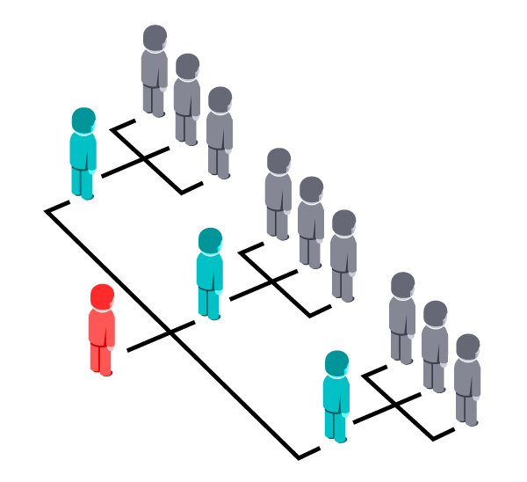
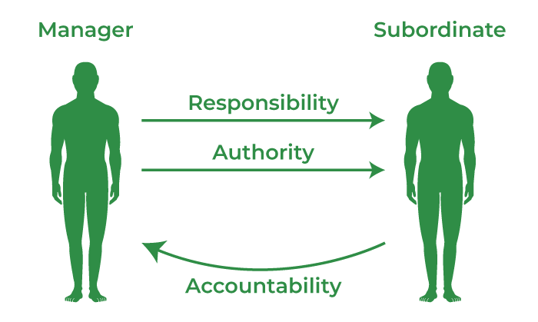
Principles of Management
Division of Work
Authority and Responsibility

Slide 9

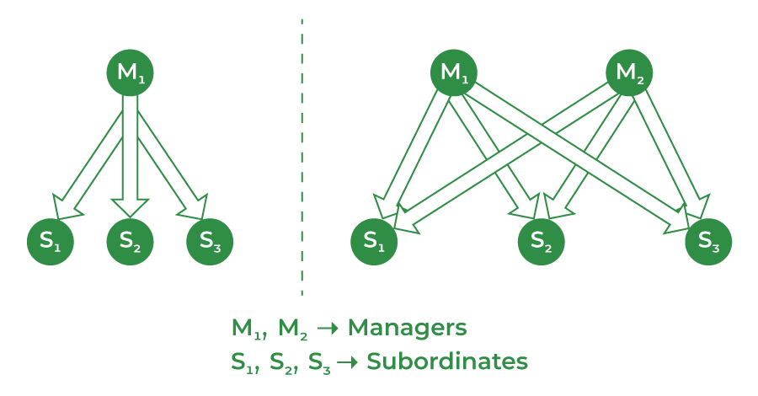

3. Discipline
4. Unity of Command
5. Unity of Direction

Slide 10
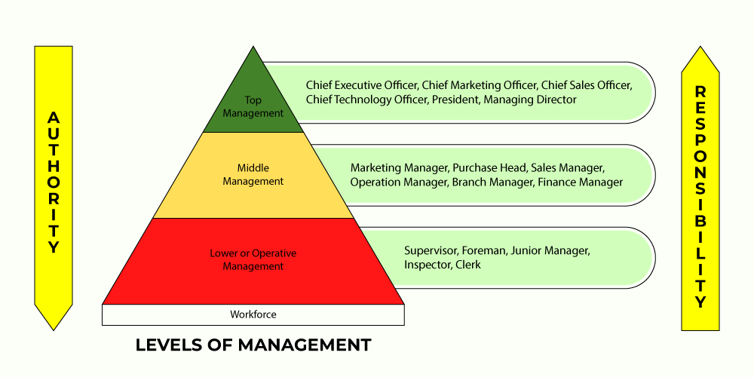
Levels of management
Top-level management: Responsible for overseeing the entire organization
Middle-level management: Responsible for executing plans and acting as a link between top-level and low-level management
Low-level management: Responsible for executing tasks and deliverables

Slide 11
1.3 Function of management: Planning, organizing, leading /directing, staffing and controlling
Management functions
Planning: Defining the organization's strategy and direction
Staffing: Recruiting and building a team for the organization
Organizing: Putting the organization's structure in place
Directing: Ensuring that employees work efficiently and effectively
Controlling: Overseeing the organization to ensure that objectives are met

Slide 12
1.4. Types of planning and step in planning
1. Strategic Planning
2. Tactical Planning
3. Operational Planning
4. Contingency Planning
5. Financial Planning
6. Project Planning
7. Human Resource Planning

Slide 13
1. 5 Types of organization, step in organizing
1] Identifying the Work:
2] Grouping of Work
3] Establish Hierarchy
4] Delegation of Authority
1.6 Function areas of management
Personnel management 2. Financial Management 3. Marketing Management 4. Production Management 5. Purchase Management 6. Development Management

Slide 14
1.7 Manageraial skills
Communication: The ability to share information clearly and effectively, both verbally and in writing
Organization: The ability to manage time and workload, and to stay on top of deadlines and events
Problem solving: The ability to identify and solve problems quickly and effectively
Decision making: The ability to identify issues, weigh options, and make clear decisions
Delegation: The ability to share tasks with others to save time and reduce stress
Conflict resolution: The ability to identify the cause of conflicts and come up with solutions that benefit everyone
Motivation: The ability to provide goals and objectives, and to find ways to make work more engaging
Technical skills: The ability to apply specialized knowledge and expertise to perform tasks such as preparing financial statements or analyzing market research

