Slide 1
Unit – IV Stack

Slide 2
Outcomes
4.1 Introduction to Stack: Definition, Stack as an ADT, Operations on Stack-(Push, Pop), Stack Operation Conditions – Stack Full / Stack Overflow, Stack Empty /Stack Underflow.
4.2 Stack Implementation using Array and representation using Linked List.
4.3 Applications of Stack: Reversing a List, Polish Notations, Conversion of Infix to Postfix Expression, Evaluation of Postfix Expression.
4.4 Recursion: Definition and Applications.

Slide 3
4.1 Introduction to Stack: Definition, Stack as an ADT, Operations on Stack-(Push, Pop), Stack Operation Conditions – Stack Full / Stack Overflow, Stack Empty /Stack Underflow.
What is Stack Data Structure?
Stack is a linear data structure based on LIFO (Last In First Out) principle in which the insertion of a new element and removal of an existing element takes place at the same end represented as the top of the stack.
Means the last element inserted inside the stack is removed first.
To implement the stack, it is required to maintain the pointer to the top of the stack , which is the last element to be inserted because we can access the elements only on the top of the stack.

Slide 4
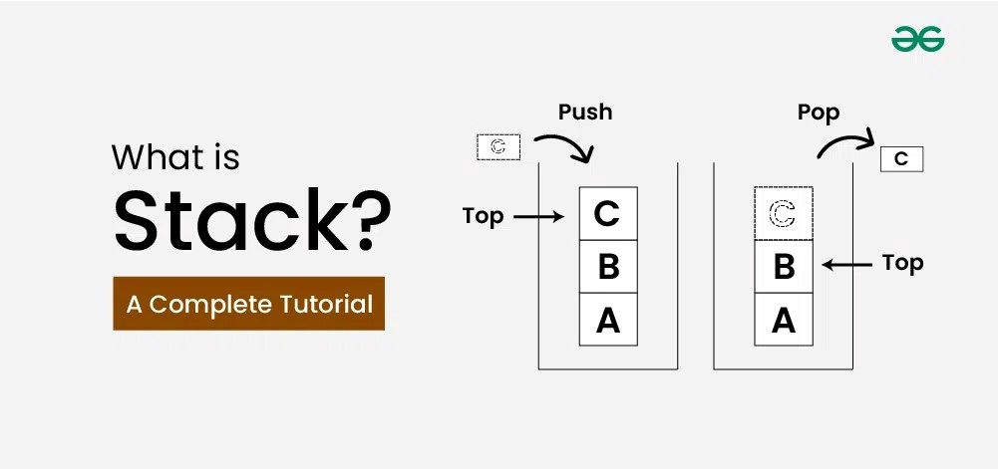
LIFO(Last In First Out) Principle in Stack Data Structure:
This strategy states that the element that is inserted last will come out first. You can take a pile of plates kept on top of each other as a real-life example.
The plate which we put last is on the top and since we remove the plate that is at the top, we can say that the plate that was put last comes out first.

Slide 5
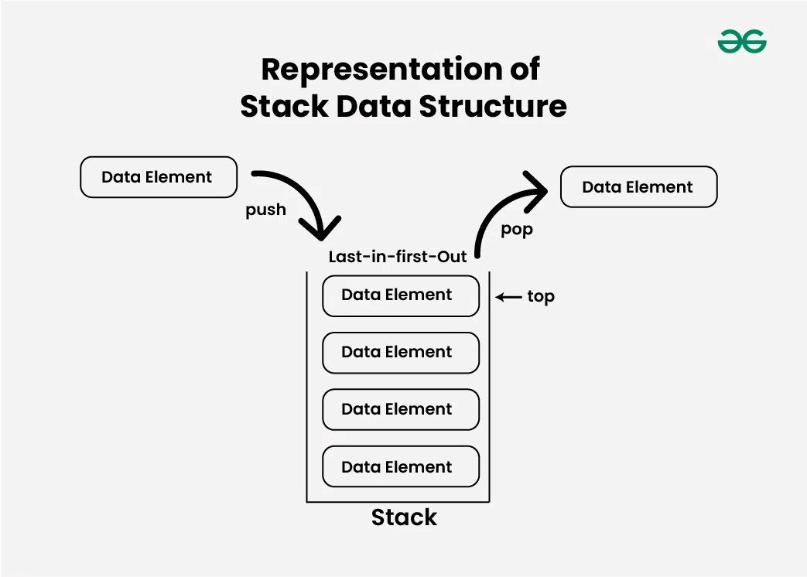

Slide 6
Types of Stack Data Structure:
Fixed Size Stack : As the name suggests, a fixed size stack has a fixed size and cannot grow or shrink dynamically. If the stack is full and an attempt is made to add an element to it, an overflow error occurs. If the stack is empty and an attempt is made to remove an element from it, an underflow error occurs.
Dynamic Size Stack : A dynamic size stack can grow or shrink dynamically. When the stack is full, it automatically increases its size to accommodate the new element, and when the stack is empty, it decreases its size. This type of stack is implemented using a linked list, as it allows for easy resizing of the stack.
Basic Operations on Stack Data Structure:
In push() to insert an element into top of the stack
pop() to remove an element from the the top of stack
top() Returns the top element of the stack.
isEmpty() returns true if stack is empty else false.
isFull() returns true if the stack is full else false.

Slide 7
Push Operation in Stack Data Structure:
Adds an item to the stack. If the stack is full, then it is said to be an Overflow condition.
Algorithm for Push Operation:
Before pushing the element to the stack, we check if the stack is full .
If the stack is full (top == capacity-1) , then Stack Overflows and we cannot insert the element to the stack.
Otherwise, we increment the value of top by 1 (top = top + 1) and the new value is inserted at top position .
The elements can be pushed into the stack till we reach the capacity of the stack.
Let Stack (Max) is an array for implementation of stack, Item is element to be inserted in stack:

Slide 8
PUSH Algorithm:
1. if TOP==MAX-1 then //[check stack is overflow)
2. print "Stack is full";
3. else
4. Accept Item to be inserted from user
5. set TOP-top+1
6. Stack[TOP]=Item

Slide 9
4.2 Stack Implementation using Array and representation using Linked List.
4.1.2 Stack as an Abstract Data Type
A stack is structured, as an ordered collection of items where items are added to and removed from the end called the "TOP."
Stacks can also be defined as Abstract Data Type (ADT). The stack abstract data type is defined by the writing its structure and operations. Stacks are ordered LIFO. In order to create stack as ADT one can write following functions and their functionality:
1. CREATE: This operation creates a new stack. This operation is used to create an empty stack. Initially set the value of TOP is -1 which is used to show the stack is empty.
Algorithm:
CREATE (Stack)
Step 1: Initialization begins
Set TOP-1
Step 2: Exit

Slide 10
2. PUSH: The process of adding a new element to the top of stack is called PUSH operation. In other words, "insertion of an element into stack is called PUSH operation."
Algorithm:
PUSH (stack, TOP, size, item)
Step 1: Check for stack overflow,
If TOP > size
message "stack overflow"
return
Step 2: Set the position of TOP pointer
Set TOP = TOP + 1

Slide 11
Step 3: Apply insertion
stack[TOP]=item
Step 4: Exit
Pushing an element in the stack invoke adding of element, as the new element will be inserted at the top and after every push operation the top is incremented by one.
3. POP: The process of deleting an element from the top of stack is called POP operation. In other words, "deletion of an element from stack is called POP operation".
Algorithm:
POP (Stack, TOP, size, item)
Step 1: Check underflow condition,
If TOP = -1 then
message "underflow"
exit

Slide 12
Step 2: Delete the TOP element
Set item = stack[[TOP]
Step 3: Set the value of TOP
Set top = TOP-1
Step 4: Return
After every POP operation the stack is decremented by one.
4. isEmpty(): This operation checks whether a stack is empty. This operation returns TRUE if the stack is empty and false otherwise.
5. isFull(): This function is used to check whether a stack becomes full or not.
In addition, a stack can have following operations:
1. init: Initialize the stack pointer.

Slide 13
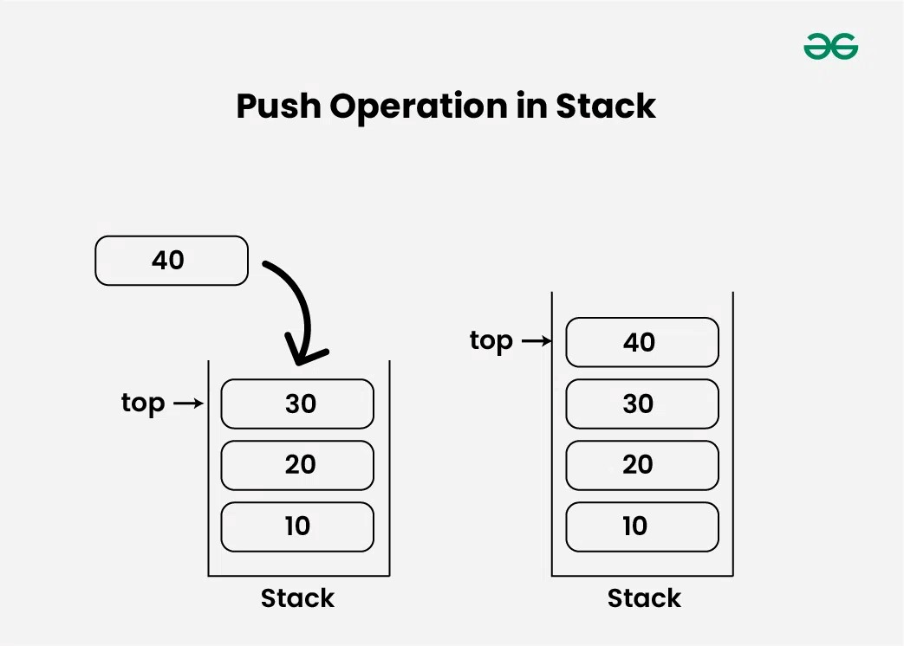
2. display: Displays the content of the stack.
3. size(): Returns the number of items in a stack.
4. TOPO: Returns the first element of a stack.
4.1.3 Operations on Stack (PUSH and POP)

Slide 14
Pop Operation in Stack Data Structure:
Removes an item from the stack. The items are popped in the reversed order in which they are pushed. If the stack is empty, then it is said to be an Underflow condition.
Algorithm for Pop Operation:
Before popping the element from the stack, we check if the stack is empty .
If the stack is empty (top == -1), then Stack Underflows and we cannot remove any element from the stack.
Otherwise, we store the value at top, decrement the value of top by 1 (top = top – 1) and return the stored top value.

Slide 15
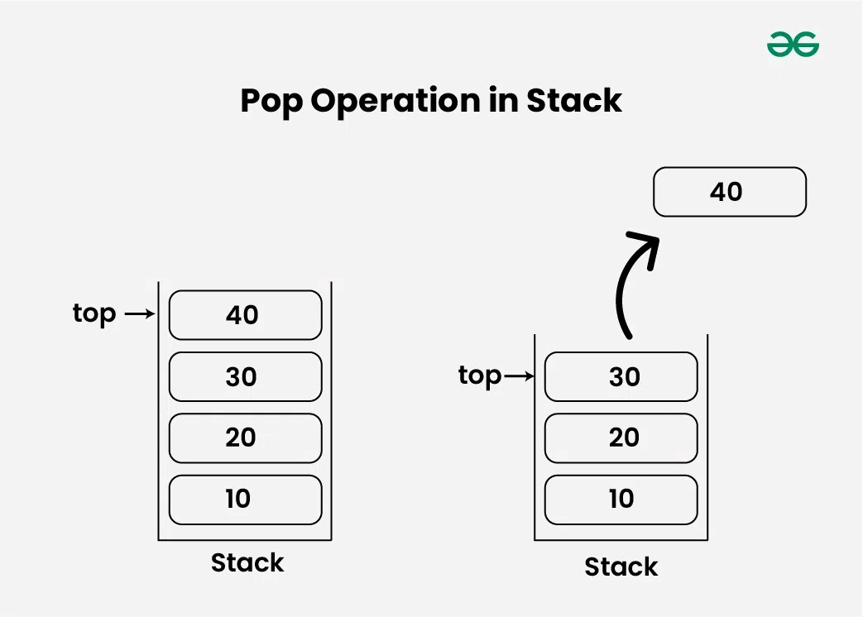

Slide 16
Let Stack [Max] is an array for implementation of stack:
1. if top==-1 then // [check stack is underflow]
2. print Stack is empty;
3. else
4. Item stack[top]
5. set top-top-+1
Stack OperationConditions –
Stack Full / Stack Overflow =
Returns true if the stack is full, else false.

Slide 17
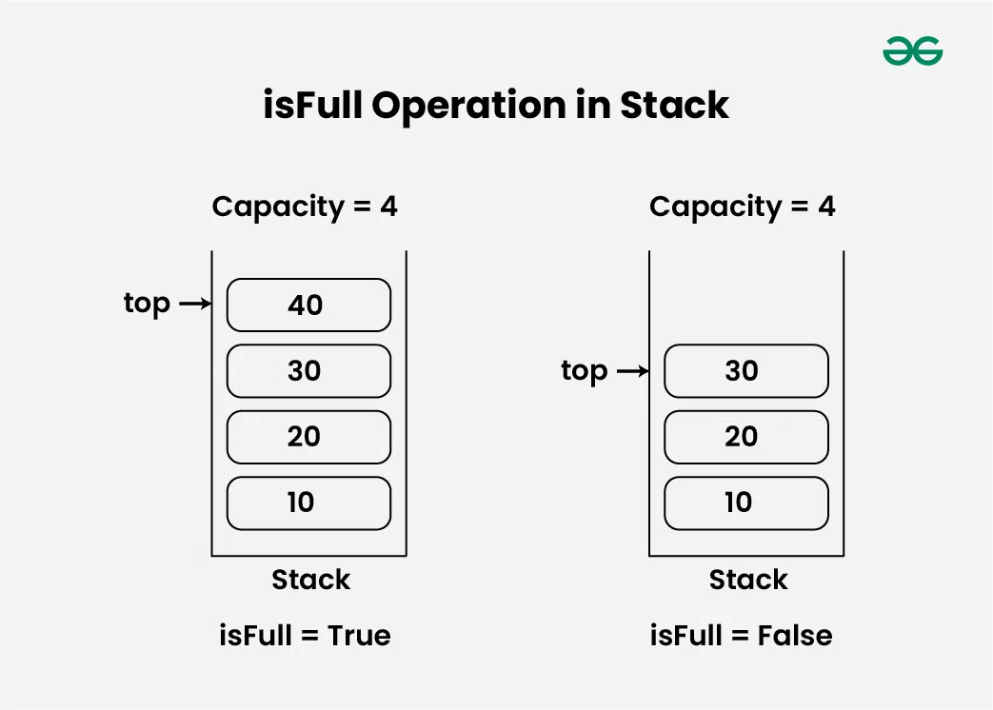

Slide 18
4.3 Applications of Stack: Reversing a List, Polish Notations, Conversion of Infix to Postfix Expression, Evaluation of Postfix Expression.
Prefix Expressions (Polish Notation)
Prefix expressions are also known as Polish notation, are a mathematical notation where the operator precedes its operands. This differs from the more common infix notation, where the operator is placed between its operands.
In prefix notation, the operator is written first, followed by its operands. For example, the infix expression “a + b” would be written as “+ a b” in prefix notation.
Operands are either numbers or variables that can be replaced by numbers to evaluate the expressions.
Operators are symbols symbolizing the operation to be performed between operands present in the expression.

Slide 19
Advantages of Prefix Expressions
No need for parentheses, as the operator always precedes its operands.
Easier to parse and evaluate using a stack-based algorithm.
Can be more efficient in certain situations, such as when dealing with expressions that have a large number of nested parentheses.
Disadvantages of Prefix Expressions
Can be difficult to read and understand for humans.
Not as commonly used as infix notation.
Infix Notation =
In infix notation, each operator is written between the operands. For example: P * Q + R * S is an arithmetical expression written in infix notation, here * denotes multiplication. In this expression P and Q are two operands and * is an operator, similarly R and S are the two operands and * is an operator.

Slide 20
Exponents have precedence one.
Multiplication and Division has precedence two.
Addition and subtraction have precedence three.
Postfix Expressions (Reverse Polish Notation)
Postfix expressions are also known as Reverse Polish Notation (RPN), are a mathematical notation where the operator follows its operands. This differs from the more common infix notation, where the operator is placed between its operands.
In postfix notation, operands are written first, followed by the operator. For example, the infix expression “5 + 2” would be written as “5 2 +” in postfix notation.
Advantages of Postfix Notation
Also eliminates the need for parentheses.
Easier to read and understand for humans.

Slide 21
Disadvantages of Postfix Expressions
Requires a stack-based algorithm for evaluation.
Can be less efficient than prefix notation in certain situations.

Slide 22
Comparison of Infix, Prefix and Postfix Expressions
Let’s compare infix, prefix, and postfix notations across various criteria:
spect | Infix Notation | Prefix Notation (Polish Notation) | Postfix Notation (Reverse Polish Notation)
Readability | Human-readable | Less human-readable, requires familiarity | Less human-readable, requires familiarity
Operator Placement | Between operands | Before operands | After operands
Parentheses Requirement | Often required | Not required | Not required
Operator Precedence Tracking | Required, parentheses determine precedence | Not required, operators have fixed precedence | Not required, operators have fixed precedence
Evaluation Method | Left-to-right | Right-to-left | Left-to-right
Ambiguity Handling | May require explicit use of parentheses | Ambiguity rare, straightforward evaluation | Ambiguity rare, straightforward evaluation
Unary Operator Handling | Requires careful placement | Simplified handling due to explicit notation | Simplified handling due to explicit notation
Computer Efficiency | Less efficient due to precedence tracking and parentheses handling | More efficient due to fixed precedence and absence of parentheses | More efficient due to fixed precedence and absence of parentheses
Usage | Common in everyday arithmetic and mathematical notation | Common in computer science and programming languages | Common in computer science and programming languages

Slide 23
Conversion of Infix to Postfix Expression=
Infix expression: The expression of the form “a operator b” (a + b) i.e., when an operator is in-between every pair of operands.
Postfix expression: The expression of the form “a b operator” (ab+) i.e., When every pair of operands is followed by

