Slide 1


SUB - OS
4. MEMORY MANAGMENT
4.1 Basic Memory Management: Partitioning - Fixed and Variable, Free Space Management Techniques: Bit map, Linked List
4.2 Swapping, Compaction, Fragmentation, Partitioning Algorithms: First fit, Best fit, Worst fit
4.3 Non-contiguous Memory Management Techniques: Paging, Segmentation
4.4 Virtual Memory: Basics, Demand paging, Page Fault
4.5 Page Replacement Algorithm: First In First Out (FIFO), Least Recently Used (LRU), Optimal
BY - MS VIRKAR S. S

Slide 2

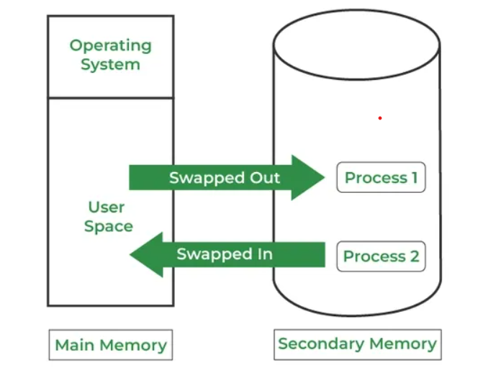
4.2 SWAPPING
🔹 Definition:
Swapping is a memory management technique in which a process is temporarily moved out of main memory (RAM) to secondary storage (like hard disk) and brought back into memory when needed.
Swapping moves processes between main memory and secondary memory to manage limited memory space. It allows multiple processes to run by temporarily swapping out lower priority processes for higher priority ones. The swapped-out process resumes once it's loaded back. Transfer time depends on the amount of data swapped.
Swapping
🔹 Purpose:
It helps the CPU execute more processes than the available physical memory allows.
🔹 Example:
Suppose the RAM can hold only 1 processes at a time.
Currently loaded: P1 If a new process P2 needs to be executed, the OS can swap out P1 to the hard disk and load P2:
Before swapping: | P1 |
After swapping: | P1 | (P1 is on disk)
🔹 Advantages:
Allows more processes to run.💡 Real-World Example:
Imagine your phone has limited RAM — say 4 GB.
You are using WhatsApp and YouTube at the same time.
When you open a game, the phone may temporarily pause (swap out) WhatsApp data to internal storage to make space for the game in RAM.
When you go back to WhatsApp, it takes a second to reload — that’s because it is swapped back into memory.
Improves CPU utilization.
🔹 Disadvantages:
Increases execution time due to disk I/O (swap in/out time).
💡 Real-World Example:
Imagine your phone has limited RAM — say 4 GB.
You are using WhatsApp and YouTube at the same time.
When you open a game, the phone may temporarily pause (swap out) WhatsApp data to internal storage to make space for the game in RAM.
When you go back to WhatsApp, it takes a second to reload — that’s because it is swapped back into memory.

Slide 3
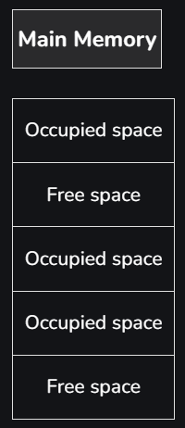
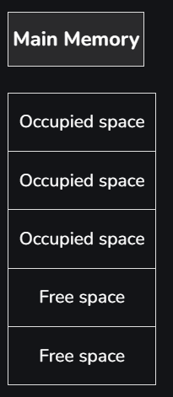
COMPACTION
🔹 Definition:
Compaction is the process of shifting processes in memory to one side to combine all free memory space into one large block.
Compaction is a technique to collect all the free memory present in the form of fragments into one large chunk of free memory, which can be used to run other processes
🔹 Purpose:
To reduce external fragmentation and make room for new processes.
🔹 Example:
Suppose memory looks like this:
| P1 | Free | P2 | P3 | Free |
There are free spaces, but they are scattered (not continuous).
After compaction, the OS rearranges memory:
| P1 | P2 | P3 | Free (combined) |
Now, one large free block is available for a new process.
🔹 Advantages:
Reduces external fragmentation.
Makes large continuous memory space available.
🔹 Disadvantages:
Time-consuming (processes need to be moved).
Can’t be done in all systems (especially real-time systems).
BEFORE COMPACTION
AFTER COMPACTION
Real life Ex:
Think of your mobile gallery with photos and videos scattered in different folders.
When you defragment or “organize storage,” the phone moves files around so that all empty spaces are together — making it easier to store a large video file.

Slide 4
FRAGMENTATION
🔹 Definition:
Fragmentation occurs when memory is divided into small pieces, and not all of it can be used efficiently.
There are two types:
(a) Internal Fragmentation
Occurs within a partition.
When a process doesn’t fully use the allocated memory block.
Example: If each partition is 10 KB and process P1 needs only 7 KB:
Partition size: 10 KB
Process P1 uses: 7 KB
Unused (wasted): 3 KB → Internal fragmentation
(b) External Fragmentation
Occurs when free memory is divided into small non-contiguous blocks.
Total free memory is enough, but not in one continuous block.
Example:
| P1 | Free(2KB) | P2 | Free(3KB) | P3 | Free(5KB) |
If a new process needs 8 KB, it can’t be allocated — even though total free = 10 KB — because free blocks are not continuous.
🔹 How to Reduce Fragmentation:
Internal: Use variable-size partitions or paging.
External: Use compaction or non-contiguous memory allocation methods (like paging or segmentation).

Slide 5
NON-CONTIGUOUS MEMORY MANAGEMENT
Non-Contiguous Memory Management
🔹 Definition:
In non-contiguous memory management, a process’s memory is not stored in one continuous block of RAM.
Instead, it is divided into smaller parts and stored in different locations in memory.
This helps the OS use memory efficiently and avoid external fragmentation.
Paging
2. Segmentation

Slide 6
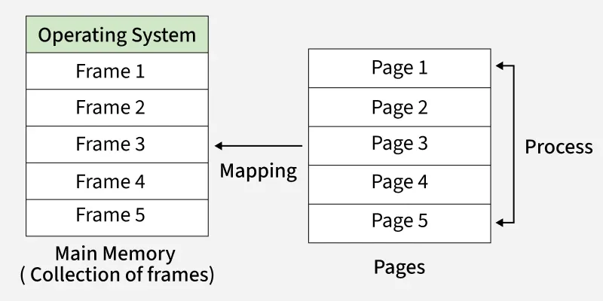
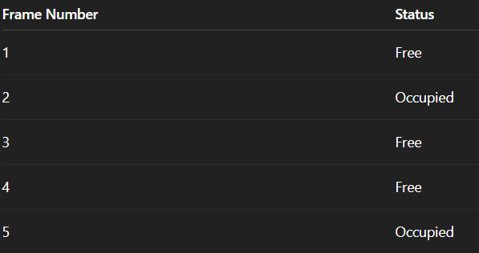
PAGING
Definition:
Paging is a memory management technique where physical memory (RAM) and logical memory (process) are both divided into equal-sized fixed blocks.
Logical blocks → called Pages
Physical blocks → called Frames
Each page of a process is stored in any free frame in memory (not necessarily continuous).
🧩 Simple Idea
When a process is too big to fit in one continuous area of RAM,
➡️ The OS divides it into small equal parts called Pages.
➡️ The RAM is also divided into equal parts called Frames.
➡️ Each page of the process is stored in any free frame (anywhere in RAM).
So, pages of one process can be spread all over the memory — not necessarily together.
📘 Example
Let’s say a program (process) needs 3 pages to run:
Page 1, Page 2, Page 3
And the RAM (main memory) has free frames like this
Frame NumberStatus
Now the OS can put:
Page 1 → Frame 1
Page 2 → Frame 3
Page 3 → Frame 4
✅ All pages are stored, even though they are not together in memory.
Real-World Example
Imagine your notebook has multiple subjects.
You tear out the pages of one subject (say "Maths") and keep them in different drawers.
To find them later, you keep a list (page table) of which drawer has which page.
Even though your Maths pages are not together, you can still read them in the right order using your list.

Slide 7
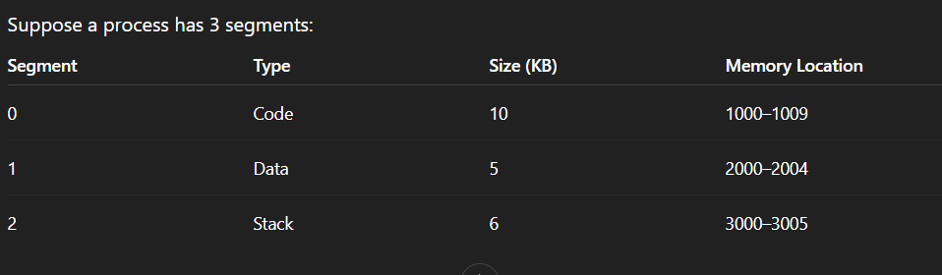
SEGMENTATION
🔹 Definition:
Segmentation divides a process into variable-sized logical parts called segments based on the program’s structure.
Each segment represents a logical unit such as:
Code segment (instructions)
Data segment
Stack segment
Heap segment
Segments are of different sizes and stored in different memory locations (non-contiguously).
🔹 Example:
These segments are stored in different parts of memory (non-contiguous), and the OS uses a Segment Table to keep track of them.
🔹 Real-World Example:
Think of a movie project —
Video clips,
Audio files, and
Subtitles —
are all stored in different folders, but when you play the movie, your video editor combines them properly using a project file (segment table).

Slide 8
VIRTUAL MEMORY
Virtual memory is a memory management technique that gives an illusion of having more RAM than actually available by using a part of the hard disk as temporary memory.]
💡 Explanation:
When the physical RAM is full, the operating system moves some data or programs that are not currently in use to a special area on the hard disk called the swap space or page file.
When that data is needed again, it is swapped back into RAM.
🧠 Simple Example:
Suppose your computer has 4 GB RAM, but you open programs that need 6 GB.
The extra 2 GB is stored temporarily on the hard disk — this is virtual memory.
So, the system works as if it has 6 GB total memory (4 GB real + 2 GB virtual).

Slide 9
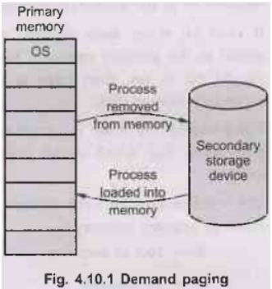
DEMAND PAGING
Definition:
Demand Paging is a method of loading pages into memory only when they are needed, not all at once.
In paging, the program is divided into pages —
but in demand paging, only the required pages are brought into RAM when the process starts executing.
🔹 Example:
Suppose a process has 10 pages, but it only needs Page 1 and Page 2 initially.
The OS loads only those 2 pages into memory.
When Page 5 is needed later, the OS brings it from disk to memory on demand.
💡 Real-World Example:
When you open a large PDF file, your computer doesn’t load all 500 pages at once —
it loads only the pages you are currently viewing.
When you scroll to page 300, it loads that page on demand.
That’s demand paging.
🔹 Advantages:
Saves memory space.
Reduces loading time.
Enables execution of large programs.
🔹 Disadvantages:
Page faults can occur often if many pages are needed suddenly.

Slide 10
PAGE FAULT
A page fault occurs when a process tries to access a page that is not currently present in the main memory (RAM). The operating system then fetches the required page from secondary storage (disk) into memory.
Types of Page Faults:
Minor Page Fault – Page is in memory but not mapped to the process.
Major Page Fault – Page is not in memory and must be loaded from disk.
Invalid Page Fault – Process tries to access a page that doesn’t exist.
Imagine you are reading notes and suddenly realize one topic is missing.
You go to your cupboard (hard disk) to fetch that missing notebook (page).
Once you bring it back to your desk (RAM), you continue studying.
That trip to the cupboard = Page Fault Handling.
🔹 Steps in Handling a Page Fault:
CPU detects missing page → triggers Page Fault.
OS locates the page on the disk.
OS loads it into a free frame in RAM.
Page table is updated.
Process resumes.

Slide 11
4.1 BASIC MEMORY MANAGEMENT:
PARTITIONING - FIXED AND VARIABLE
Partitioning is a technique used by the operating system to divide the main memory into parts (called partitions) so that multiple processes can be loaded and executed simultaneously.
Types of Partitioning
There are two main types of partitioning:
1.Fixed Partitioning
2.Variable Partitioning

Slide 12
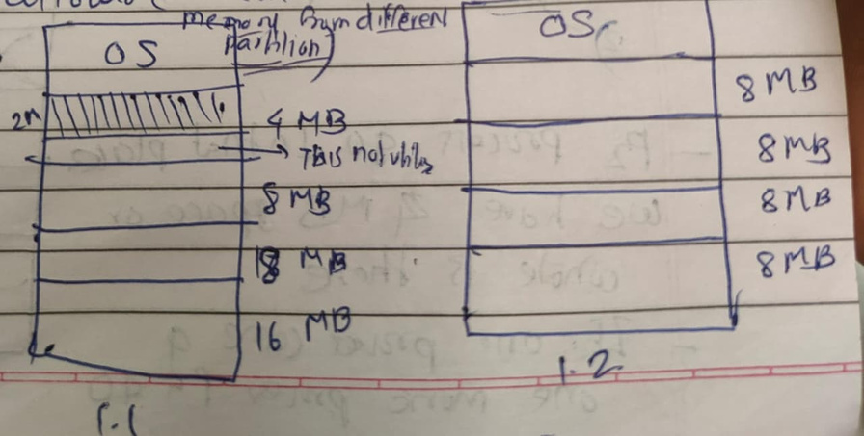
1.FIXED PARTITIONING
In Fixed Partitioning, memory is divided into fixed-size partitions at system startup.
Each partition can contain only one process at a time.
🔹 Characteristics
·Limit in degree of multiprogramming
→ Because the number of partitions is fixed, only that many processes can be in memory.
·Internal fragmentation occurs
→ If a process is smaller than the partition, the remaining space inside the partition is wasted.
·External fragmentation
→ Occurs when free partitions exist but are too small to hold new processes.
·Limit in partition size
→ A process cannot exceed the size of a partition, even if total memory is available.
Advantages
1.Simple to implement and manage.
2.Easy to keep track of memory usage.
Disadvantages
1.Internal fragmentation leads to wasted memory.
2.Limited degree of multiprogramming — fixed number of processes can run.

Slide 13
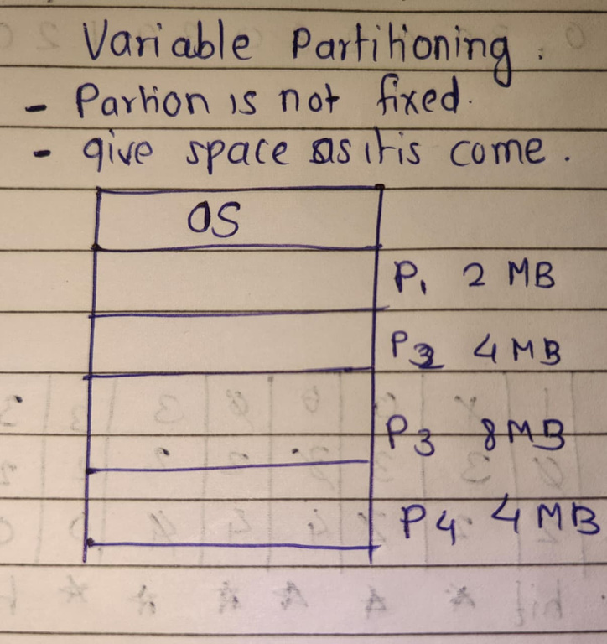
2 . VARIABLE PARTITIONING
In Variable Partitioning, memory is divided dynamically according to the size of processes.
Partitions are created and removed as needed.
Characteristics
·No limit in size
→ A process can take exactly the amount of memory it needs.
·No internal fragmentation
→ Since partitions are created based on process size.
·No external fragmentation (can be reduced using compaction).
→ Memory can be compacted to make larger free blocks available.
Advantages
1.Efficient memory utilization — less wasted space.
2.Degree of multiprogramming can increase dynamically as memory allows.
Disadvantages
1.Memory management is complex (needs compaction and bookkeeping).
2.External fragmentation can still occur before compaction.

Slide 14
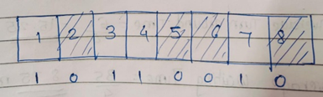
FREE SPACE management techniques
1.Bit Map Method
Example
Suppose memory is divided into 8 blocks, each 1 KB in size:
Block Number 1 means the block is occupied
•0 means the block is free
Thus, blocks 2, 5, 6, and 8 are available for new processes.
When multiple processes are loaded and removed from memory, free spaces (holes) appear in different parts of memory.
The Operating System (OS) must keep track of which parts of memory are free and which are allocated — this is known as Free Space Management (or Free Memory Management).
1.Bit map –
In an Operating System, a Bit Map (or Bit Vector) is a data structure used to keep track of free and allocated memory blocks (or disk blocks).
It uses bits (0s and 1s) to represent the status of each memory unit:
•0 → Block is free (available)
•1 → Block is allocated (in use) This technique is widely used in:
•Main memory management
•Disk space management
•File systems (like FAT, NTFS, Linux ext2/3)
Advantages of Bit Map Method
1. Simple and compact representation.
2. Less memory overhead (only one bit per block).
Disadvantages :
1. Searching time: The OS must scan the bit map to find free blocks.
2. Slow for large memories (many bits to check).

Slide 15
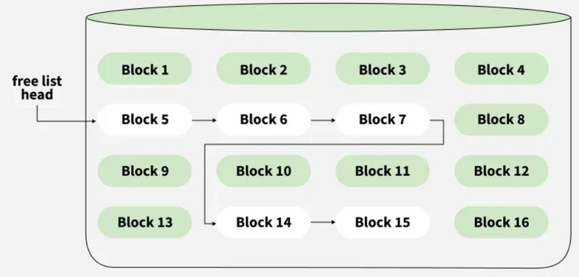
FREE SPACE management techniques
2. Linked List
–
In Operating Systems, the Linked List method is a free space management technique used to keep track of free and allocated memory blocks (or holes).
Instead of using bits (like in a Bit Map), the OS uses a linked list of nodes, where each node represents a block of free memory.
Free block are linked together in a list
Each free block stores the adress of next free blockIf two adjecent block become free they can be merged into large block to reduce fragmentation
Advantages of Bit Map Method
1. No wastage of Space
1.Efficient memory use: No need for fixed-size partitions.
2.Merging possible: Adjacent free blocks can be combined (reduces external fragmentation).
Disadvantages :
1.External fragmentation: Free blocks can still be scattered.
2.Complex management: Merging and splitting require careful bookkeeping.
Example
The free space list head points to Block 5 which points to Block 6, the next free block and so on.
The last free block would contain a null pointer indicating the end of free list

Slide 16
PARTITIONING ALGORITHMS: FIRST FIT, BEST FIT, WORST FIT
1. First Fit Algorithm
1.Allocates the first available memory block that is large enough to fit the process.
2.Memory is scanned from the beginning, and the first suitable hole is selected.
3.It is simple and fast, but may lead to external fragmentation over time.
2. Best Fit Algorithm
1.Allocates the smallest available block that is large enough for the process.
2.Searches the entire list of free blocks before allocation.
3.Reduces internal fragmentation but causes many small unusable holes (external fragmentation).
3. Worst Fit Algorithm
1.Allocates the largest available block to the process.
2.The idea is to leave the biggest remaining hole, hoping to fit future processes.
3.Causes more internal fragmentation, but can reduce small scattered holes.

Slide 17
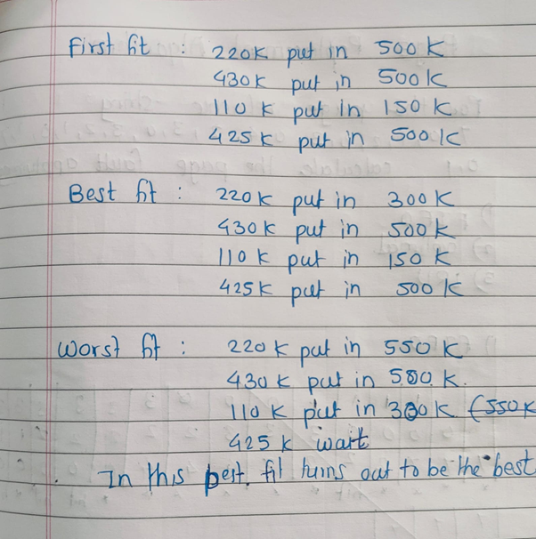
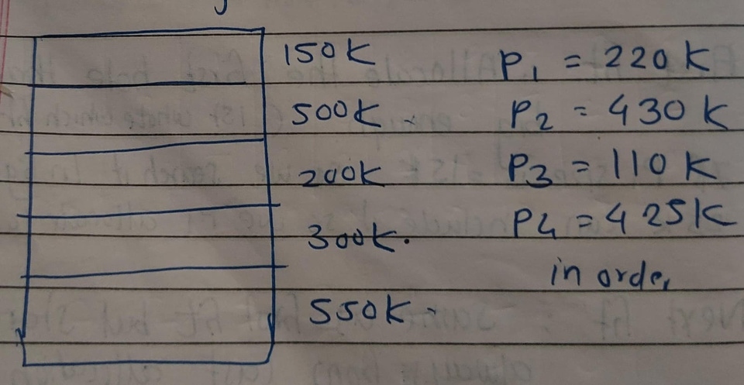
PARTITIONING ALGORITHMS: FIRST FIT, BEST FIT, WORST FIT
Example.
If Memory Partition is 150k 500k,200k,300k,550k in order, how would
each of the first fit, best fit, worst fit algorithm place the process of220k,430k,110k,425k,which algorithm make most efficient use of memory

Slide 18
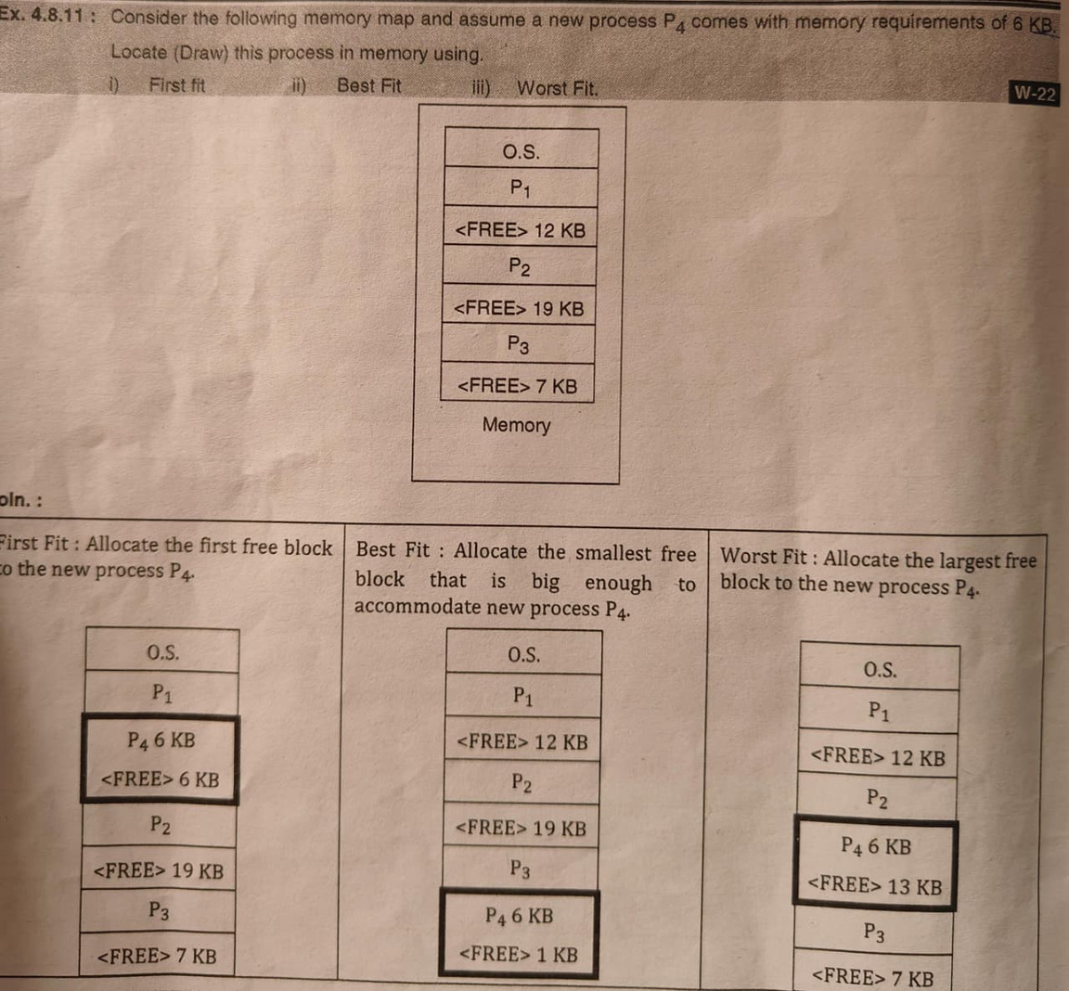
PARTITIONING ALGORITHMS: FIRST FIT, BEST FIT, WORST FIT

Slide 19
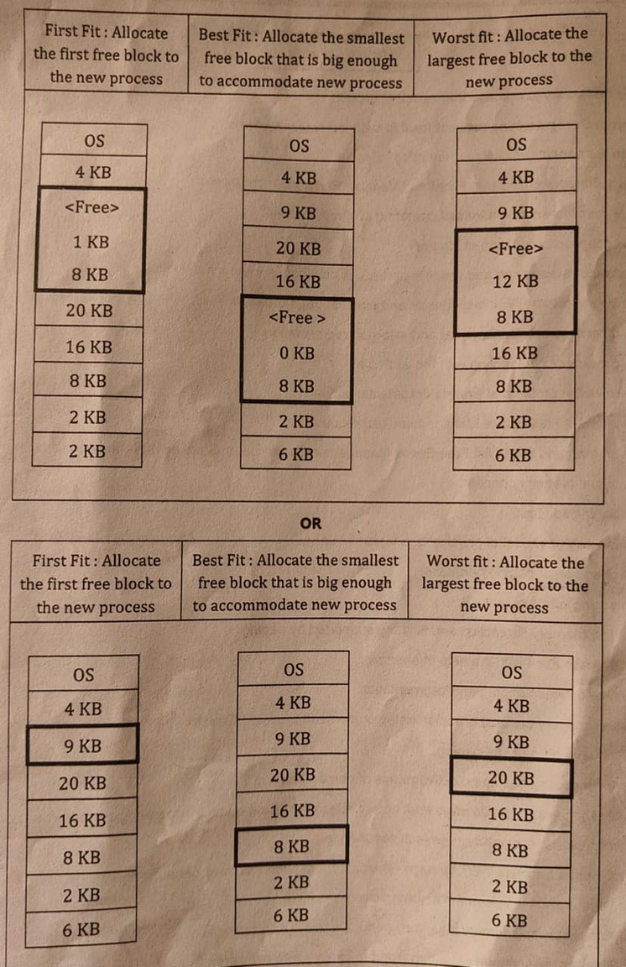
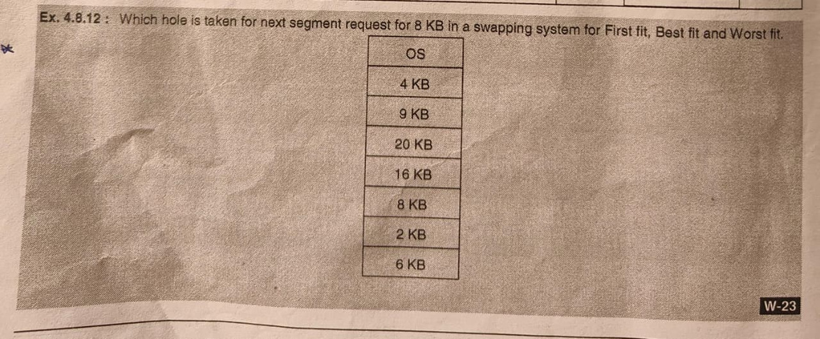

Slide 20
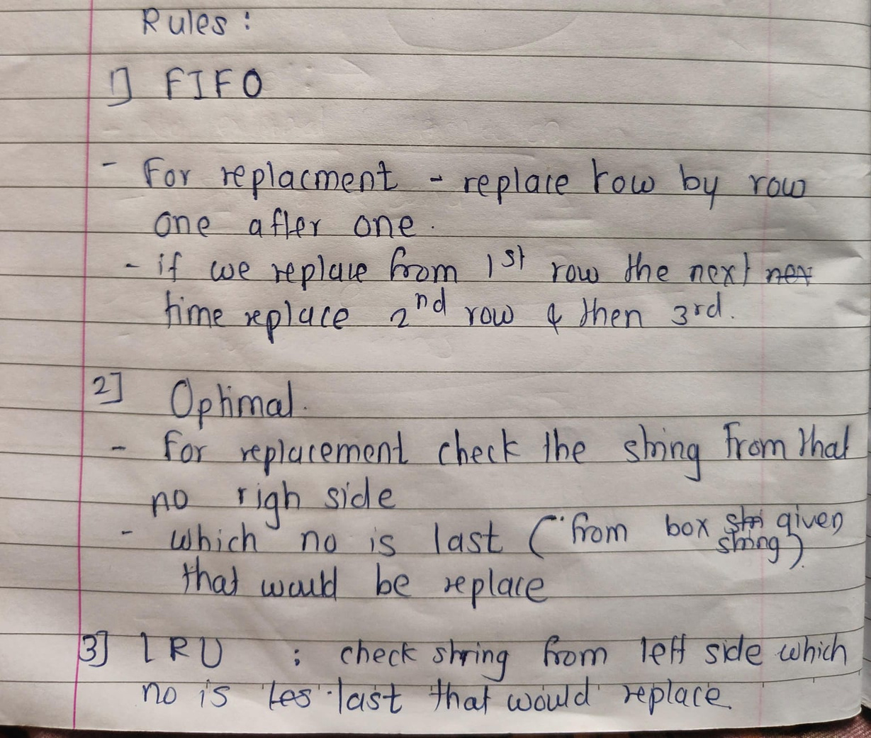
PAGE REPLACEMENT ALGORITHM

Slide 21
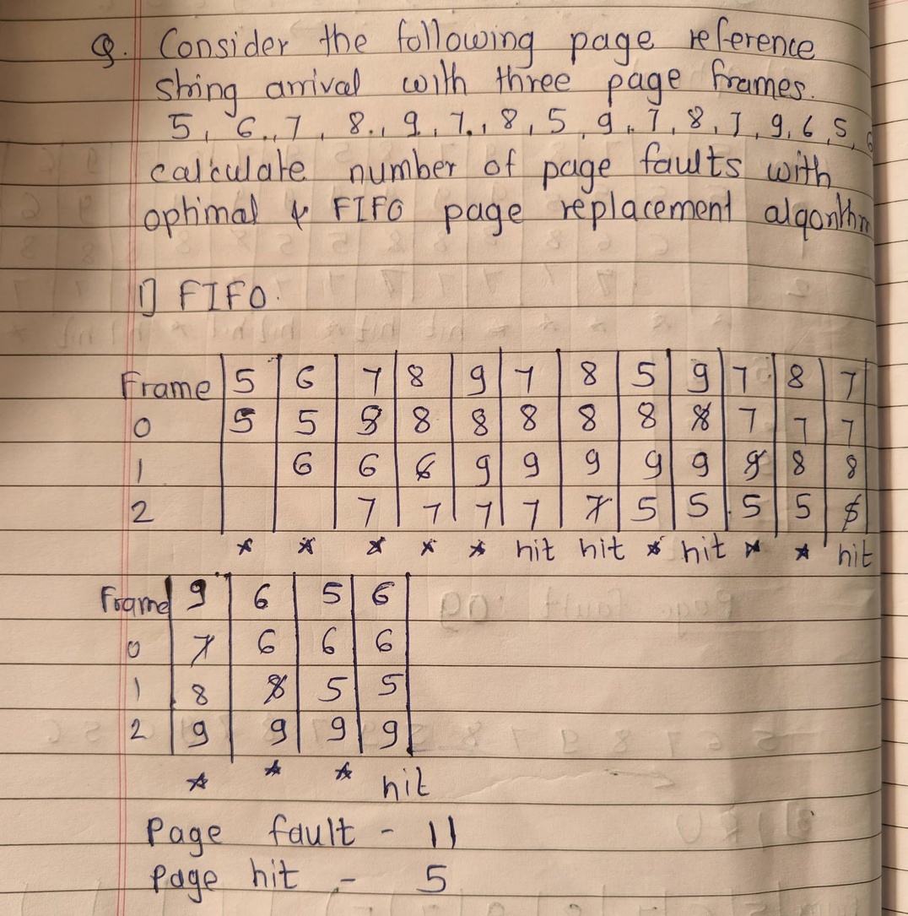
PAGE REPLACEMENT ALGORITHM
Solve Like This

Slide 22
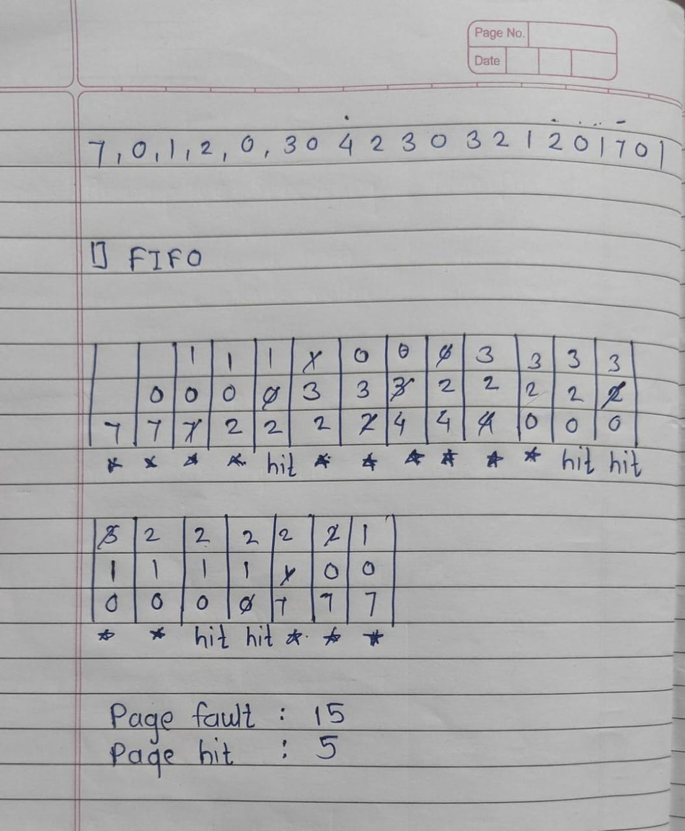
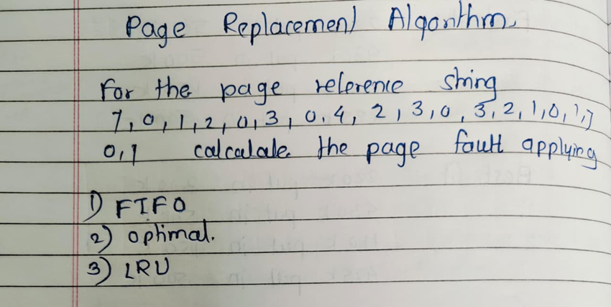
PAGE REPLACEMENT ALGORITHM
Add upper side frame
while calculating

Slide 23
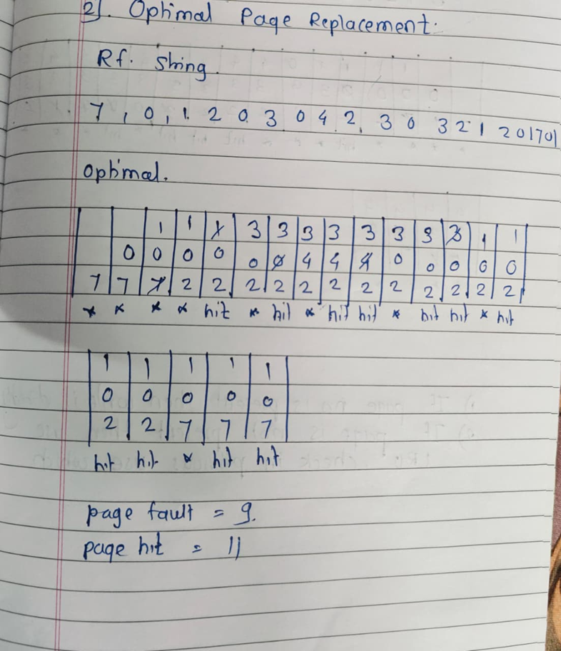
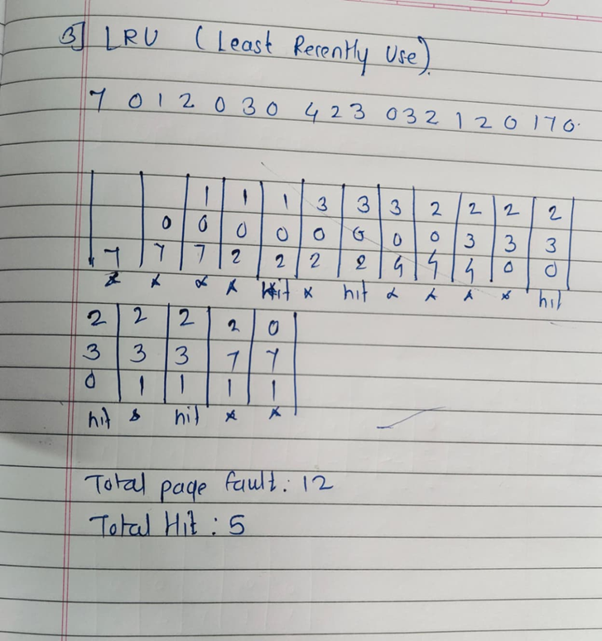
PAGE REPLACEMENT ALGORITHM

Slide 24

5. FILE MANAGMENT
5.1 File Concepts: Attributes, Operations, File types and File system structure
5.2 Accessing Methods: Sequential, Direct
5.3 File Allocation Methods: Contiguous allocation, Linked allocation, Indexed allocation
5.4 Directory Structure: Single level, Two level, Tree structured Directory
BY - MS VIRKAR S.S

Slide 25
FILE TYPE
In an operating system, files are classified based on their content and use. The OS treats each file as an object that can be opened, read, written, or deleted.
🔹 1. Regular Files
These are normal files that store user data or program information.
Can contain text, binary data, or executable code.
Most commonly used file type.
Examples: notes.txt, program.c, image.jpg, data.exe
Types of Regular Files:
Text files – Human-readable (e.g. .txt, .cpp)
Binary files – Machine-readable (e.g. .exe, .obj)
🔹 2. Directory Files
These are special system files that store information about other files.
Each directory entry contains file names and related metadata (like size, location, permissions).
Used to organize files hierarchically.
Example: /home/student/notes/ (a directory containing many files)

Slide 26
FILE TYPE
3. Character Special Files
Used to represent I/O devices that handle data character by character.
No buffering; data is transferred one character at a time.
Found in UNIX/Linux systems under /dev.
Examples: /dev/tty (terminal), /dev/lp0 (printer), /dev/keyboard
🔹 4. Block Special Files
Represent devices that store data in blocks (fixed-size chunks).
The OS reads or writes whole blocks at a time.
Used for disks and storage devices.
Examples: dev/sda (hard disk), /dev/mmcblk0 (memory card)

Slide 27
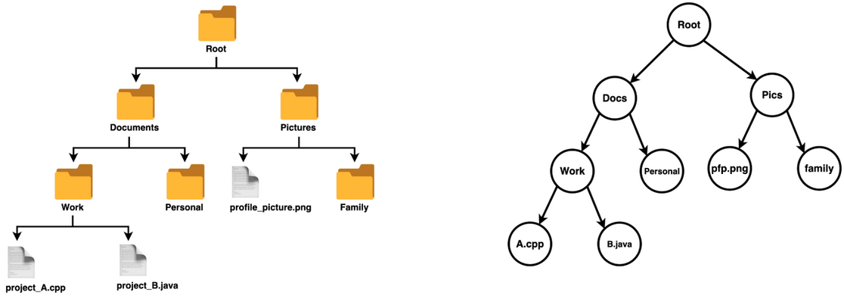
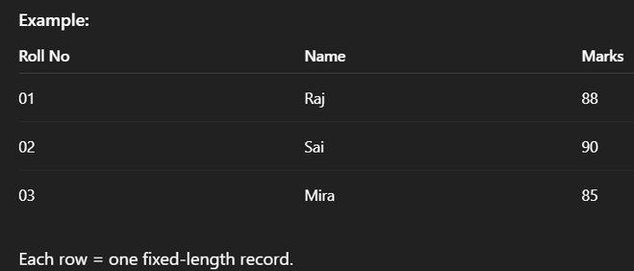
FILE SYSTEM STRUCTURE
A File System defines how data and files are organized and stored on storage devices.
Different OS use different file structures to manage files efficiently.
🔹 1. Unstructured Sequence of Bytes
The simplest type of file structure.
A file is just a sequence of bytes with no fixed internal format.
The application program decides how to interpret the bytes (text, image, code, etc.).
Used in UNIX/Linux systems.
Example:
A .txt file with characters stored as bytes:
H e l l o W o r l d
(each letter = 1 byte)
🔹 2. Sequence of Fixed-Length Records
The file is divided into records of equal size.
Each record may represent a student record, employee record, etc.
Easier to read/write specific records directly.
Common in database systems.
Example:
3. Tree Structure (Hierarchical File System)
Files are organized in a tree-like structure with directories (folders) and subdirectories.
The root directory ("/") is at the top.
This structure allows easy navigation and management.
Explanation:
→ Root directory
document,pitures → Subdirectories
project_B.java , project_A.cpp→ Files inside directories

Slide 28
FILE ACCESS METHODS
Access methods define the way data in a file is read or written.
Different applications require different ways to access data — for example, a text editor reads data sequentially, while a database might access data directly.
🔹 Types of Access Methods:
1️⃣ Sequential Access Method
🔹 Definition:
In Sequential Access, data in a file is accessed in order, one record after another — from the beginning to the end.
You must read data in sequence, and cannot skip directly to a specific record.
🔹 Explanation:
Used in files where data is arranged in a fixed order.
Most text files and log files use this method.
Suitable for devices like magnetic tapes, which are sequential in nature.
🔹 Operations:
read next() – Reads the next record.
write next() – Appends new data at the end.
reset() – Goes back to the beginning of the file.
🔹 Diagram:
+-----+| Record1 | Record2 | Record3 | Record4 | ... |+-----+
↑ ↑ ↑
Read in this order only
🔹 Example:
Reading student records from a list:
1. Read student 1
2. Read student 2
3. Read student 3
You cannot directly jump to student 3 without reading the first two.
2️⃣ Direct Access (Random Access) Method
🔹 Definition:
In Direct Access, also called Random Access, data can be read or written directly to any record without following order.
Each record has a unique address or key, allowing direct access.
🔹 Explanation:
Suitable for disks and storage devices that allow movement to any block.
Used in databases, index files, or virtual memory systems.
🔹 Diagram:
+-------------------------------------------+
| Record1 | Record2 | Record3 | Record4 | Record5 |
+-------------------------------------------+
↑ ↑
Access directly Access directly
🔹 Example:
Accessing a student record directly by Roll No:
Access Record No. 50 directly without reading 1–49
3. Other Access Method
_can build on top OF Random access method
sevral factors are important
minumum access time
ease to update
simple maintenance
Reliability

Slide 29
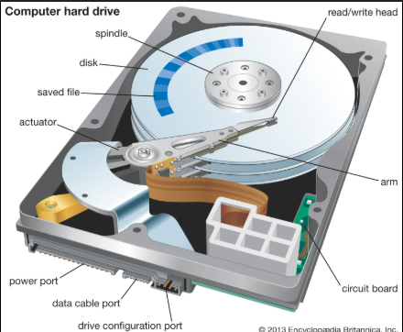
FILE MANAGEMENT IN OPERATING SYSTEM
File Management in Operating System
1️⃣ Definition:
File Management is a function of the Operating System (OS) that handles the creation, organization, storage, access, and protection of files on a computer system.
It allows users and applications to store and retrieve data easily.
2️⃣ Functions of File Management:
File Creation and Deletion –
File Access and Reading/Writing –
File Organization –
File Protection and Security –
File Naming and Attributes –
File Allocation –
BY - MS VIRKAR S.S

Slide 30
ATTRIBUTES
A file is a logical unit of storage used to store information on a computer.
Each file has certain characteristics called file attributes, which describe the file’s properties like name, type, size, and permissions.
Common File Attributes:
Name:
It is the name given to the file by the user.
Used to identify and access the file easily.
🟢 Example: notes.txt, report.docx.
Type:
Describes the kind of file or its format.
Helps the OS know which program can open it.
🟢 Example: .txt (text file), .jpg (image file), .exe (executable file).
Size:
Shows the amount of data stored in the file.
Measured in bytes, KB, MB, or GB.
🟢 Example: photo.jpg = 2.5 MB.
Location:
Give the location of the file
Give the path of the file
🟢 Example: C:\user\shree\Downloads

Slide 31
OPERATION ON FILES
The Operating System allows users to perform various operations on files.
The four common file operations are:
Create:
To create a new file and allocate space for it.
Open:
To open an existing file for reading, writing, or updating.
Read:
To read data or contents from a file.
Write:
To write or add new data to a file.
5.Close:
After the work done all access get finished

Slide 32
FILE ALLOCATION METHODS
The allocation methods define how the files are stored in the disk blocks. There are three main disk space or file allocation methods.
Contiguous Allocation
Non Contigous Allocation
Linked Allocation
Indexed Allocation
The main idea behind these methods is to provide Efficient disk space utilization & Fast access to the file blocks.

Slide 33
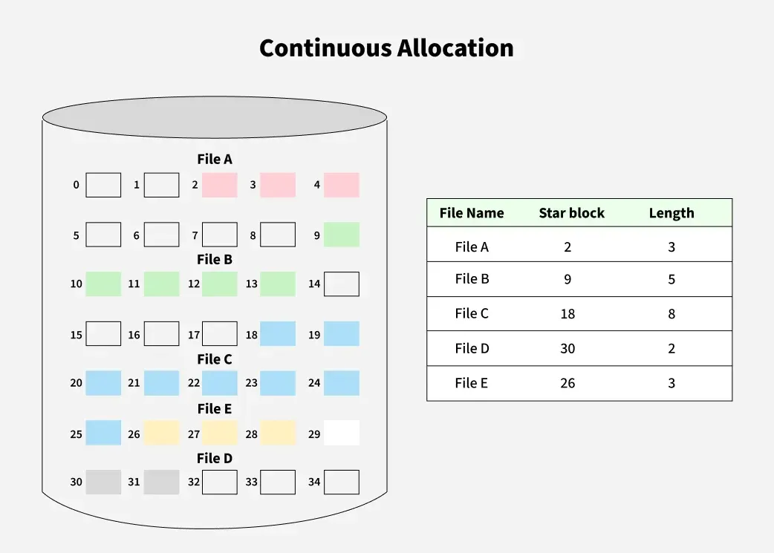
CONTIGUOUS ALLOCATION
Contiguous Allocation
Each file occupies a set of contiguous (adjacent) blocks on the disk.
The directory stores the starting block and length of the file.
Address of starting block
Length of the allocated portion.
Example: If a file requires n blocks and is given a block b as the starting location, then the blocks assigned to the file will be
b, b+1, b+2,......b+n-1.
📘 Diagram:
[File A] → [Block 2][Block 3][Block 4]
✅ Advantages:
Fast sequential and direct access.
Simple to implement and manage.
❌ Disadvantages:
Causes external fragmentation.
Difficult to grow files (no free space next to it).

Slide 34
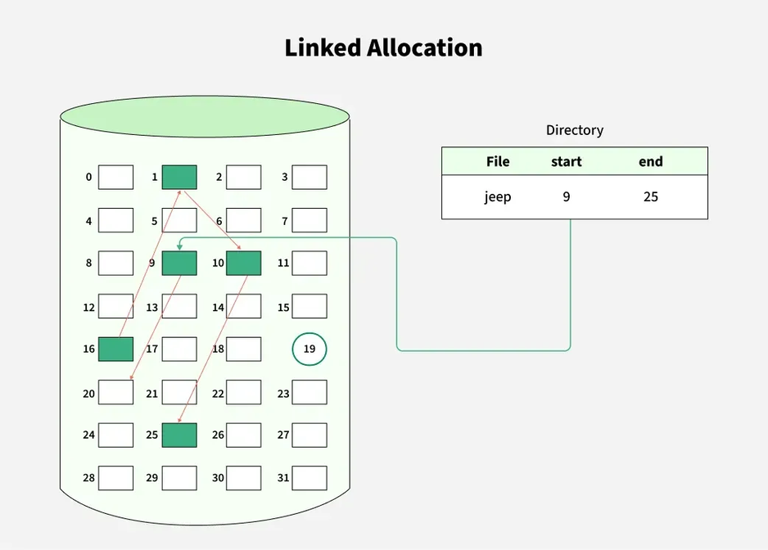
LINKED ALLOCATION
Each file is a linked list of disk blocks scattered anywhere on the disk.
Each block contains a pointer to the next block.
The disk blocks can be scattered anywhere on the disk. The directory entry contains a pointer to the starting and the ending file block.
Each block contains a pointer to the next block occupied by the file.
Example: The file 'jeep' in following image shows how the blocks are randomly distributed. The last block (25) contains -1 indicating a null pointer and does not point to any other block.bh
📘 Diagram:
[File B] → [Block 9] → [Block 13] → [Block 18] → [NULL]
✅ Advantages:
No external fragmentation.
Easy to expand files dynamically.
❌ Disadvantages:
Slow direct access (must follow pointers).
Pointer corruption may break the chain.

Slide 35
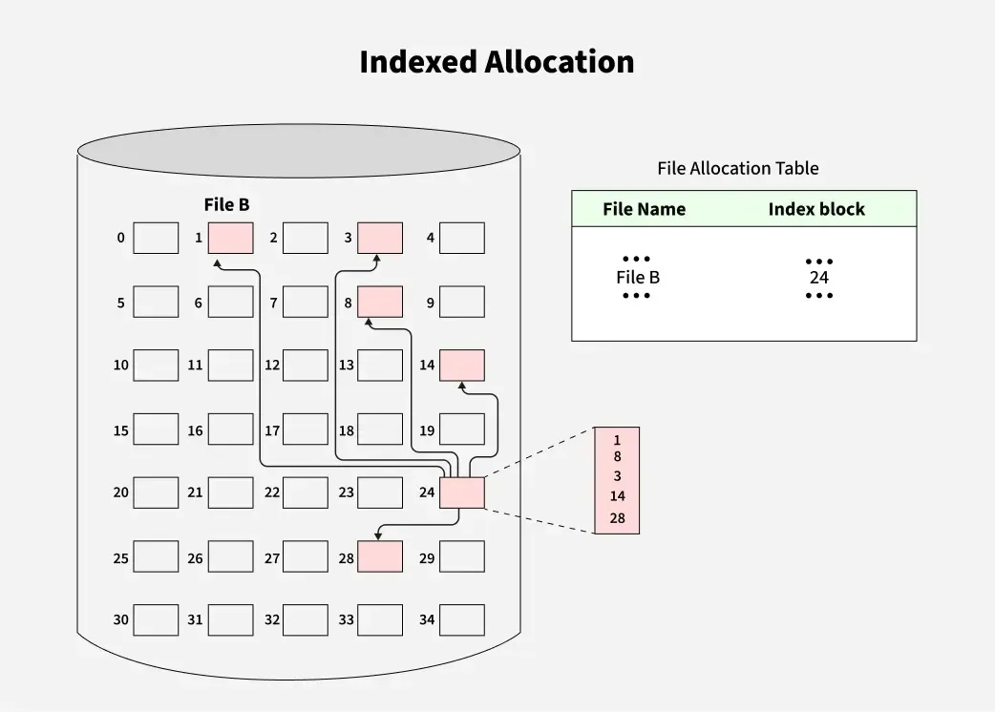
INDEXED ALLOCATION
Each file has an index block that stores the addresses of all its data blocks.
The directory entry points to this index block.
In this scheme, a special block known as the Index block contains the pointers to all the blocks occupied by a file. Here,
Each file has its own index block.
The ith entry in the index block contains the disk address of the ith file block.
The directory entry contains the address of the index block as shown in the image
✅ Advantages:
Supports direct and sequential access.
No external fragmentation.
❌ Disadvantages:
Extra space needed for the index block.
Managing large files may need multiple index blocks.

Slide 36
STRUCTURES OF DIRECTORY IN OPERATING SYSTEM
The operating system uses directories to track where files are stored, just like using folders to organise papers.
Different directory structures can be used to suit various organisational needs.
Understanding directory structures helps in organising and accessing files more easily.
By using these structures, it becomes simpler to manage and navigate files on your computer.
Different Types of Directories in OS
In an operating system, there are different types of directory structures that help organise and manage files efficiently. Each type of directory has its own way of arranging files and directories, offering unique benefits and features. These are
Single-Level Directory
Two-Level Directory
Tree Structure/ Hierarchical Structure

Slide 37
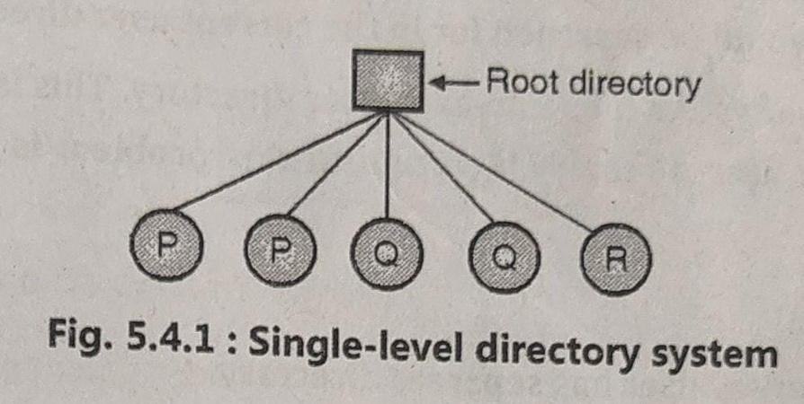
SINGLE-LEVEL DIRECTORY
Only one directory is used for the entire system.
All files of all users are stored in one place.
File names must be unique, otherwise conflict occurs.
Very simple to understand and easy to implement.
No way to organize files into folders or groups.
The single-level directory is the simplest directory structure. In it, all files are contained in the same directory which makes it easy to support and understand.
A single level directory has a significant limitation, however, when the number of files increases or when the system has more than one user. Since all the files are in the same directory, they must have a unique name. If two users call their dataset test, then the unique name rule violated.
Since it is a single directory, so its implementation is very easy.
If the files are smaller in size, searching will become faster.
The operations like file creation, searching, deletion, updating are very easy in such a directory structure.
Advantage
1.Simple to impliment
2.file small size ,searching is faster
DisAdvantage
1.Naming problem
2 . Can not group same type of file together

Slide 38
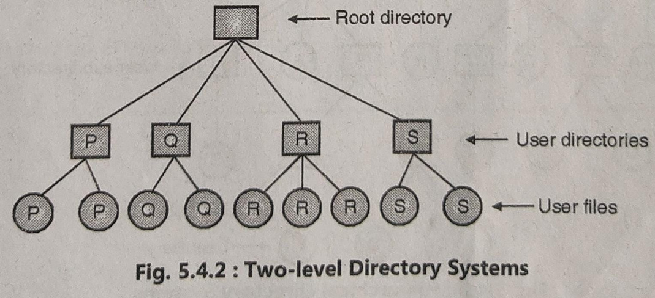
TWO-LEVEL DIRECTORY
System creates a Master File Directory (MFD) for all users.
Each user gets a User File Directory (UFD) of their own.
Users can have same file names because directories are separate.
Provides better security and privacy between users.
Does not allow subdirectories inside the user folder.
Advantages:
Provides user isolation – each user has their own directory, preventing name conflicts.
Offers better security and organization of files for multiple users.
Disadvantages:
No sharing of files between users easily.
Limited structure – only two levels (user and file),
In a two-level directory structure, each user has a separate User File Directory (UFD) containing only their files. A Master File Directory (MFD) stores entries for all users and points to their respective UFDs, preventing filename conflicts between users.
In this structure, each user has their own separate directory (called a user directory).
The main directory (called the master file directory) keeps track of all user directories.
Each user can create files in their own directory without affecting others.

Slide 39
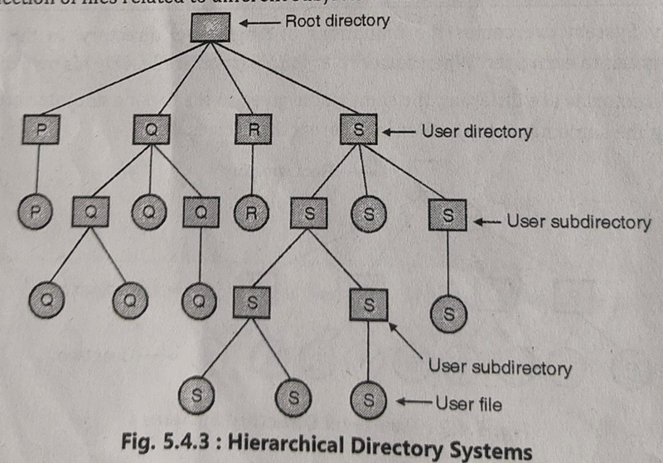
TREE STRUCTURE/ HIERARCHICAL STRUCTURE
Directory is arranged in the form of a tree, starting with a root (/).
Users can create multiple subdirectories inside their main directory.
Files are well organized into folders and subfolders.
Supports absolute and relative path names.
Provides good searching, grouping, and protection mechanisms.
The tree directory structure is the most common in personal computers. It resembles an upside-down tree, with the root directory at the top containing all user directories. Each user can create files and subdirectories within their own directory but cannot access or modify the root or other users’ directories
In this structure, directories are arranged in a tree form, where a root directory branches into subdirectories and files.
It allows grouping related files into separate directories..
Advantages:
Easy to group related files together.
Supports pathnames (absolute and relative).
Allows better searching and management.
Disadvantages:
Slightly more complex than single or two-level systems.
Requires more memory and management.
Root
├── Programs
│ ├── C
│ └── Java
├── Documents
│ ├── Notes
│ └── Reports

Slide 40
Write Unix command for following: i)create a folder OSY ii) create a file FIRST in OSY folder iii) List/display all files and directories. iv) Write command to clear the screen
Ans
i) create a folder OSY: mkdir OSY
ii)create a file FIRST in OSY folder: cd OSY
touch FIRST
iii) List/display all files and directories: ls -1
iv) to clear screen: clear

Slide 41
THANK YOU

