Slide 1

Operating System
Computer Engineering
3.CPU Scheduling
3.1 Scheduling: Basic concept, CPU and I/O burst cycle
3.2 Preemptive and Non-preemptive scheduling, scheduling criteria
3.3 Types of Scheduling algorithms: First Come First Serve(FCFS), Shortest Job First (SJF), Shortest Remaining Time Next (SRTN), Round Robin (RR), Priority Scheduling, Multilevel Queue Scheduling
3.4 Deadlock: System Models, Necessary conditions Leading to Deadlock, Deadlock Handling: Deadlock prevention, Deadlock avoidance- Banker’s Algorithm
BY Ms.Virkar.S.S

Slide 2
3.CPU Scheduling
Resource Allocation Graph (RAG)
Scheduling
·Scheduling in Operating System means deciding which process gets to use the CPU next when multiple processes are in the ready queue.
·It is important because:
1. CPU is a limited resource.
2. Many processes compete for CPU time.
3. Efficient scheduling improves CPU utilization and system performance.
👉 Definition:
CPU Scheduling is the process of selecting a process from the ready queue and allocating the CPU to it.

Slide 3
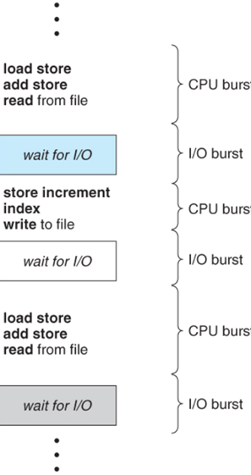
3.CPU Scheduling
CPU–I/O Burst Cycle
B) CPU–I/O Burst Cycle
·A process execution consists of CPU bursts (instructions executed by CPU) and I/O bursts (waiting for input/output).
·Processes alternate between these two.
1. CPU Burst
·Period when process is executing instructions on CPU.
·Example: Calculations in a program.
2. I/O Burst
·Period when process is waiting for I/O operations (disk read, printing, user input).
·Example: Waiting for file read/write.
Diagram: CPU–I/O Burst Cycle
CPU Burst → I/O Burst → CPU Burst → I/O Burst → ... → CPU Burst → Termination
·CPU-bound process: More CPU bursts, less I/O (e.g., heavy computations).
·I/O-bound process: More I/O bursts, short CPU bursts (e.g., text editor waiting for input).

Slide 4
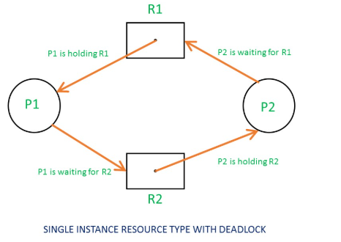
3.CPU Scheduling
Resource Allocation Graph (RAG)
A Resource Allocation Graph is a directed graph used to describe deadlock situations in a system.
Circle (○) → Process
Square (□) → Resource
Edge P → R → Process requesting resource
Edge R → P → Resource allocated to process

Slide 5
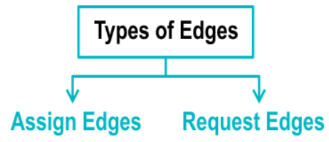
Resource Allocation Graph (RAG)
Two Types of Edges in Resource Allocation Graph
1. Request Edge
2. Assignment Edge
  Process → Resource = Request Edge (asking for it).
  Resource → Process = Assignment Edge (already got it).

Slide 6
Resource Allocation Graph (RAG)
  The set consisting of all the active processes in the system,
say P={ P1 ,P 2,..Pn}
  The set consisting of all resource types in the system,
say R= {R1,R2,...Rn}
  In this graph, directed edge from process P to instance of resource type R
indicatesthat P has requested an instance of R and currently
waiting for that resource. A directed edge from resource type R to process P
indicates that an instance of resource type R has been allocated to process P.
So, edge from process P to resource R is request edge and edge from resource R to
process P is assignment edge. Circle nodes in graph represent processes and square
represents resources.
If resource allocation graph contains cycle then deadlock may exist in the system. If
it does not contain cycle, then processes are not deadlocked.

Slide 7
Deadlock Avoidance
  The system checks before allocating resources whether the allocation will lead to a safe or unsafe situation.
  If it may cause deadlock → system does not allocate (makes the process wait).
  Works like a banker lending money only if he knows he will get it back safely.
  Idea: Always keep the system in a safe state.

Slide 8
  1. Safe State
A state is safe if there exists a sequence of processes (safe sequence) such that all processes can finish without deadlock.
The OS can always find at least one order to run processes to completion.
✅ Example:
If Available resources can satisfy one process’s needs, that process can finish → release resources → next process can finish, and so on.
  2. Unsafe State
A state is unsafe if the OS cannot guarantee all processes will finish.
Unsafe ≠ Deadlock immediately, but deadlock may happen later.
So, the system avoids entering unsafe state.
3. Deadlock State
A situation where no process can proceed because every process is waiting for resources held by others.
If system enters deadlock state → it is stuck forever.

Slide 9
Banker’s Algorithm (Deadlock Avoidance)
  Banker’s algorithm is used to avoid deadlock.
  It works like a banker giving loans:
  The banker will only give a loan if he knows he can get it back safely.
  Similarly, the OS will only allocate resources to a process if the system will remain in a safe state.
Important Terms
Available → How many resources are free at the moment.
Max → Maximum demand of each process.
Allocation (C) → How many resources are already allocated to each process.
Need (N)→ Remaining resources a process may still request.

Slide 10
Banker’s Algorithm (Deadlock Avoidance)
Step 1: Safety Check
  Work = Available
  Finish[i] = false (for all processes)
  Find a process Pi such that:
    Need[i] ≤ Work
    Finish[i] = false
  If found → allocate its resources back (Work = Work + Allocation[i]), set Finish[i] = true.
  Repeat until all processes are finished or no process can proceed.
  If all Finish[i] = true → System is in safe state.
  Else → unsafe state (deadlock may happen).
Step 2: Resource Request Algorithm
When a process requests some resources:
  If Request[i] ≤ Need[i] → OK, else error.
  If Request[i] ≤ Available → OK, else process must wait.
  Pretend to allocate resources (Available = Available – Request, Allocation = Allocation + Request, Need = Need – Request).
  Run safety check.
    If safe → grant the request.
    If unsafe → rollback and make the process wait.

Slide 11
Steps of Banker’s Algorithm
Step 1: Safety Check
This algorithm find out whether system is in safe state or not.
1. Let W be an integer array of length m, initialized to array A (Available number of resources). Let F be a boolean array of length n, initialized to false (determines if process finished or not).
2. Find such that both:
F[1] == false
go to step 4
N[i] < W
If no such i exists,go to step 4
3. W = W + C[i]
F[i] = true; Go to step 2
4. If F[l] == true for all i , then the system is in a safe state, otherwise unsafe.

Slide 12
Steps of Banker’s Algorithm
Step 2 : Resource-Request Algorithm
This algorithm decides whether requests of the resources can be safely granted so as to system will remain in safe state.
Let R[n][m] be the two dimensional array, describe the current outstanding requests of all processes. R[i][j] = k indicates process Pi want k instances of resource type Rj to accomplish the execution.
1. If R[i][j] <= N[i][j] to step 2; otherwise, raise an error condition as process is requesting more resources than it needs.
2. If R[i][j] > A[j] then the process should wait as needed resources are not available.
3. Otherwise, go to step 4
4. Allocate the requested resources to Pi. The state is altered as
A[j] = A[j] - R[i][j]
C[i][j] = C[i][j] + R[i][j]
N[i][ j = N[i][j] - R[i][j]

Slide 13
