Slide 1
Unit I - Software Development Process
Overview of Software Engineering Models and Frameworks

Slide 2
1.1 Software Characteristics & Types
• Characteristics: Correctness, Reliability, Efficiency, Integrity, Usability, Maintainability, Reusability, Portability.
• Types: System Software, Application Software, Utility Software, Embedded Software, Web-based Software.

Slide 3
Software Characteristics
Correctness:
A program is considered correct if it fulfills all its specified requirements and performs according to its intended purpose. It's about accuracy and adherence to the defined functionality.
Reliability:
Reliability means the software consistently performs its functions as expected, without errors or failures, over a specified period or under certain conditions. A reliable system minimizes the chances of unexpected behavior.
Efficiency:
Efficiency refers to how well the software uses system resources like processing power, memory, and network bandwidth. An efficient program does not waste resources and completes tasks quickly.
Integrity:
Integrity ensures that the software and data are protected from unauthorized access, modification, or destruction. It's about maintaining the consistency and accuracy of the software's information.
Usability:
Usability focuses on how easy it is for users to learn, use, and understand the software. A usable system is intuitive, efficient for users, and minimizes errors.
Maintainability:
Maintainability describes how easily the software can be modified, updated, or fixed. A maintainable system allows for efficient changes to address bugs, add features, or adapt to new environments.
Reusability:
Reusability is the ability to use software components or modules in other software projects. This helps reduce development time and effort.
Portability:
Portability is the ability of the software to be transferred and run on different hardware or software platforms without requiring significant modifications.

Slide 4
Types of Software
1. System Software:
Definition:
System software acts as an intermediary between the computer hardware and application software. It manages and controls the computer's resources and provides a platform for other software to run.
Examples:
Operating systems (like Windows, macOS, Linux, Android), device drivers, firmware, and programming language translators.
Function:
Enables the basic functioning of the computer, allowing users to interact with hardware and run applications.

Slide 5
2. Application Software:
Definition:
Application software, also known as end-user software, is designed to perform specific tasks for users.
Examples:
Word processors, spreadsheets, web browsers, media players, email clients, games, and graphics software.
Function:
Enables users to accomplish various tasks related to productivity, creativity, communication, and entertainment.

Slide 6
3. Utility Software:
Definition:
Utility software is a type of system software that helps manage, maintain, and optimize the computer system.
Examples:
Antivirus software, disk cleanup tools, file compression utilities, and backup solutions.
Function:
Enhances the performance, security, and functionality of the computer system.

Slide 7
4. Embedded Software:
Definition: Embedded software is designed to be part of a larger hardware system, often without direct user interaction.
Examples: Software in microwave ovens, washing machines, cars, and other electronic devices.
Function: Controls the specific functions of the embedded hardware device.

Slide 8
5. Web-based Software:
Definition:
Web-based software is accessed and used through a web browser over the internet.
Examples:
Online shopping websites, social media platforms, web-based email services, and online collaboration tools.
Function:
Provides access to applications and services through a network connection, allowing users to interact with software remotely.

Slide 9
1.2 Software Engineering Layered Approach
• Layers: Quality Focus, Process, Methods, Tools.
• Process: Defines framework for software development.
• Methods: Technical approaches for development.
• Tools: Automated/computer-aided support for methods.

Slide 10
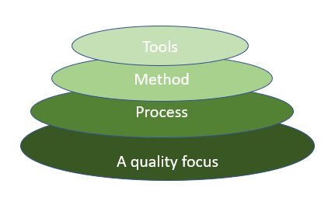
Layered Approach Diagram

Slide 11
1.3 Software Development Framework
• Structured set of practices for planning, developing, and delivering software.
• Ensures consistency, reusability, and process standardization.

Slide 12
1.4 Software Process Model - Waterfall
• Sequential phases: Requirements → Design → Implementation → Testing → Deployment → Maintenance.
• Advantages: Simple, structured.
• Disadvantages: Inflexible to changes, late testing.

Slide 13
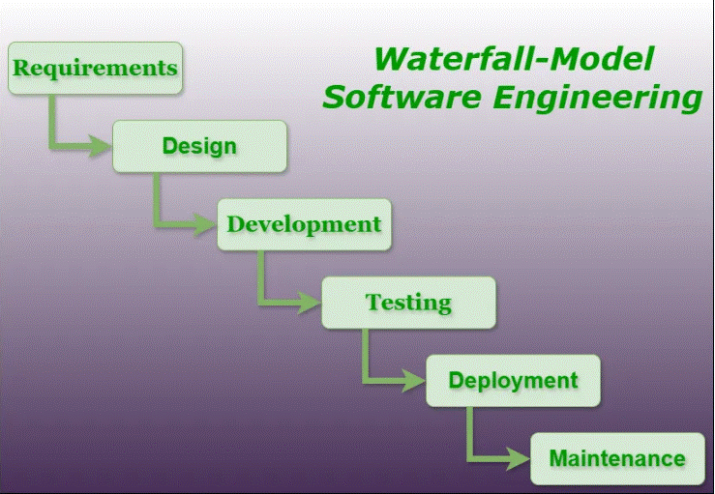
Waterfall Model

Slide 14
1.5 Incremental Process Model - RAD
• Rapid Application Development (RAD).
• Develops software in increments with prototypes.
• Focus on speed and user feedback.
• Advantages: Faster delivery, user involvement.
• Disadvantages: Requires skilled developers, not for large projects.

Slide 15
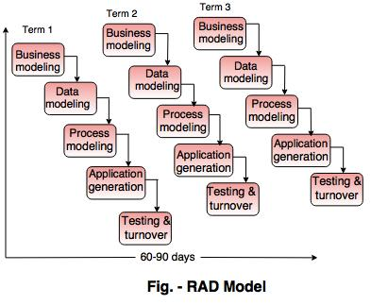
RAD Model

Slide 16
1.6 Evolutionary Models - Prototyping & Spiral
• Prototyping: Build working prototype, refine based on feedback.
• Spiral: Combines iterative development with risk analysis.
• Advantages: Risk handling, user involvement.
• Disadvantages: Costly, complex management.

Slide 17
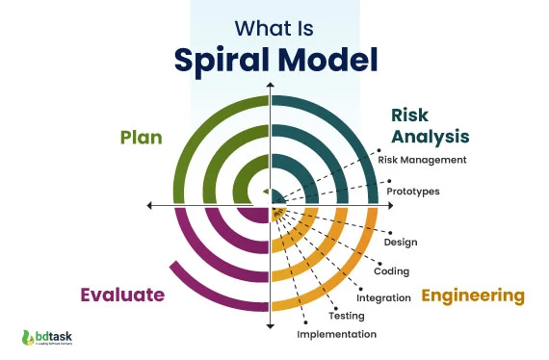
Spiral Model

Slide 18
1.7 Agile Models
• Extreme Programming (XP): Frequent releases, pair programming.
• Adaptive Software Development (ASD): Iterative, adaptive planning.
• Scrum: Sprints, roles (Product Owner, Scrum Master, Team).
• DSDM: Iterative, user involvement, time-boxing.
• Crystal: Tailored to project size/criticality.
• Agile Unified Process (AUP): Simplified version of RUP using agile techniques.

