Slide 1

Igniting Your Startup: From Idea to Impact
Welcome, future entrepreneurs! This presentation will guide you through the critical steps of selecting and developing your product or service, establishing efficient processes, and understanding your market. We'll explore how innovation, strategic thinking, and leveraging key resources can transform your vision into a thriving business.

Slide 2




Chapter 1: Product/Service Selection
Crafting Your Core Offering: Process and Competence
Selecting the right product or service is the cornerstone of any successful startup. This isn't just about a great idea; it's about a systematic process that aligns with your unique strengths and market needs.
Idea Generation
Feasibility Analysis
Brainstorming and identifying potential opportunities.
Assessing technical, financial, and market viability.
Core Competence
Strategic Fit
Identifying what your startup does uniquely well.
Ensuring alignment with long-term business goals.

Slide 3
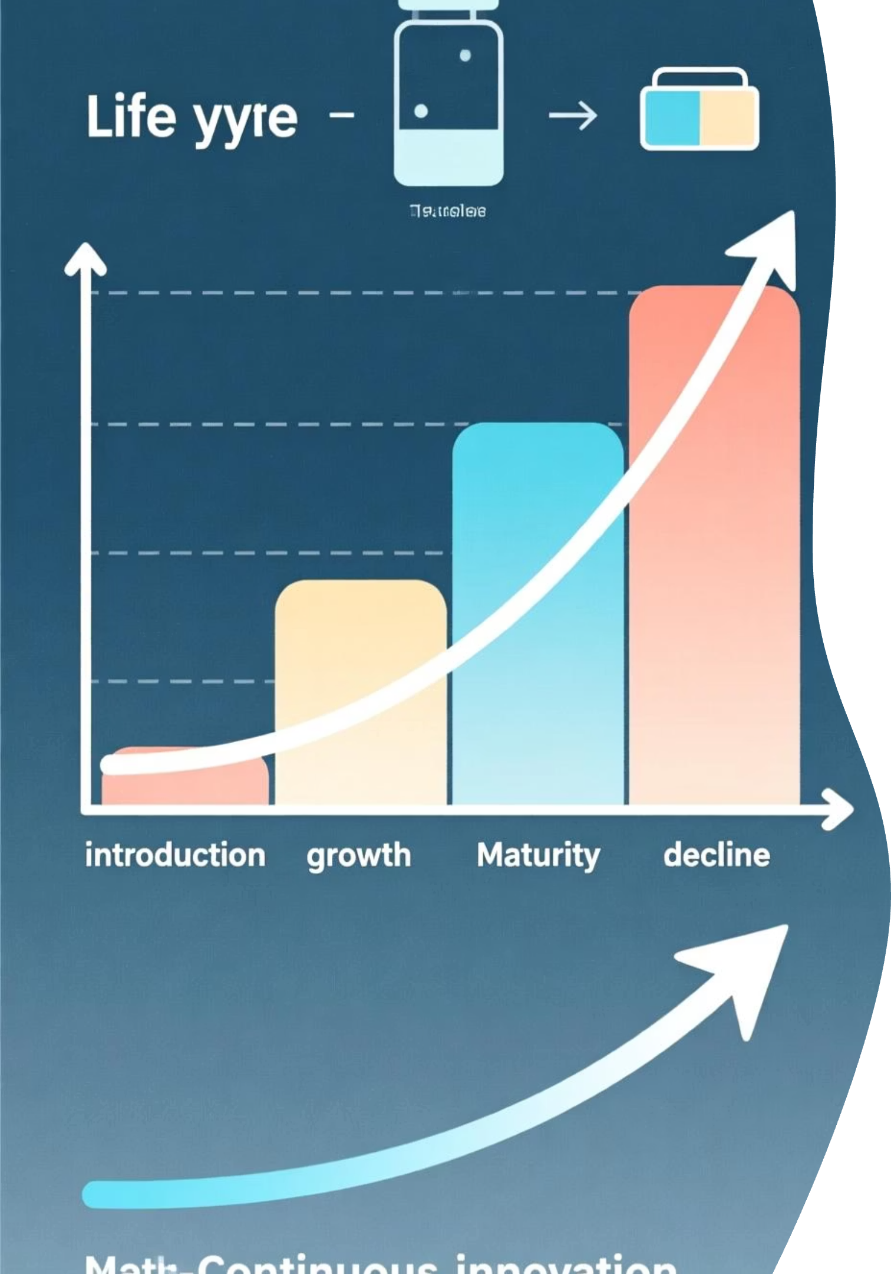
The Life Cycle of Innovation: From Concept to Longevity
Understanding the product/service life cycle is crucial for sustained growth. Just like living organisms, products and services go through stages from introduction to decline. Strategic innovation extends this life.
New Product/Service Development: A structured approach to bringing novel offerings to market.
Mortality Curve: Recognising that many startups and products don't make it past early stages and planning accordingly.
Creativity & Innovation: Essential for modification and development, keeping offerings fresh and relevant.

Slide 4
Chapter 2: Process Selection
Optimising Operations: Technology, Transformation, and Location
Efficient processes are the backbone of any successful venture. They dictate how you deliver value, manage costs, and scale your operations.
Technology Life Cycle
Factors Affecting Process Selection
Understanding the evolution and adoption of technologies that impact your production and service delivery.
Volume and variety of output
Capital investment required
Forms and Cost of Transformation
Skill level of workforce
Flexibility for future changes
Analysing how raw inputs are converted into outputs and the associated expenses.
Location for an Industry
Strategic placement considering proximity to resources, markets, and infrastructure.

Slide 5
Streamlining Your Flow: The Importance of Material Handling
Efficient material handling is often overlooked but critical for cost savings, safety, and productivity, especially in physical product-based businesses.
Reduce Damage
Increase Safety
Minimise product spoilage and waste during movement.
Implement procedures to prevent workplace injuries.
Optimise Space
Boost Efficiency
Efficient storage and movement within your facility.
Faster movement of goods translates to quicker delivery.

Slide 6

Chapter 3: Market Study Procedures
Understanding Your Audience: The Art of Market Research
Knowing your market is paramount. A thorough market study reduces risk and informs strategic decisions, ensuring your product/service resonates with your target customers.
Market Overview
Understand industry size and trends.
Customer Insights
Identify segments, needs, and behaviors.
Competitive Analysis
Map rivals, strengths, and gaps.
Quantitative Research
Collect surveys and large-sample data.
Data Analysis
Perform statistical and predictive analysis.

Slide 7
Designing Your Insights: Questionnaires and Data Analysis
Effective market research relies on well-structured procedures for gathering and interpreting information.
Questionnaire Design
Sampling
Market Survey
Data Analysis
Selecting a representative group from your target market.
Execution of your data collection plan.
Interpreting raw data to identify trends and insights.
Clear and concise questions
Various methods: online, in-person, phone.
Avoid leading questions
Translating findings into actionable business strategies.
Ensuring statistical validity for reliable results.
Logical flow
Appropriate question types (e.g., multiple choice, open-ended)

Slide 8

Chapter 4: Leveraging Support Networks
Partners in Progress: Connecting with Entrepreneurial Ecosystems
You don't have to go it alone. Numerous organisations are dedicated to supporting new and growing businesses. Leveraging their resources can provide invaluable guidance, funding, and mentorship.

Slide 9
Key Support Stakeholders for Entrepreneurs
Maharashtra Centre for Entrepreneurship Development (MCED)
Provides training, skill development, and awareness programmes for aspiring and existing entrepreneurs, particularly in Maharashtra, India.
National Institute for Micro, Small and Medium Enterprises (NI-MSME)
Offers management training, research, and consultancy services to promote MSME development across India.
Prime Minister's Employment Generation Programme (PMEGP)
A credit-linked subsidy programme aiming to generate self-employment opportunities through micro-enterprises in non-farm sectors.
Directorate of Industries (DI)
State-level government bodies that facilitate industrial development, provide various incentives, and support services to industries.
Khadi and Village Industries Commission (KVIC)
Promotes and develops Khadi and village industries for rural employment, providing financial assistance and training.

Slide 10
Key Takeaways & Next Steps
Strategic Selection: Choose your product/service and processes thoughtfully, aligning with your core strengths and market needs.
Data-Driven Decisions: Conduct thorough market research to truly understand your customer and validate your ideas.
Leverage Resources: Actively seek out and utilise support from government bodies and entrepreneurial organisations.
Continuous Learning: The entrepreneurial journey is iterative. Embrace feedback and adapt your strategies as you grow.
Your entrepreneurial journey begins now. Go forth and innovate!

